Slide 1

Care of the Child with Diabetes in School
Kathy Bratt, NP, CDE

Slide 2
Review:
Type 1 diabetes:
Insulin deficiency: auto-immune disease
antibodies destroy the cells in the pancreas
that make the hormone, insulin. The rest of the pancreas works just fine!!
It used to be called Juvenile diabetes and thought to be diabetes that was found in children and young adults.

Slide 3
Rising Incidence of Diabetes

Slide 4
Type 2
Used to be called Adult onset, as it was thought only adults developed this disease.
Insulin resistant disease, insulin does not work correctly.
If caught early, may be treated with diet and exercise, or pills, however, may need insulin to start with, or after several years.

Slide 5
Type 2
Goal:
Pre-meal and post meal glucose levels of <180mg/dl

Slide 6
Type 2
Signs and Symptoms:
Often overweight
Less active
Thirst, hunger, urination
Tired, sleepy
Gradual onset
Family history

Slide 7
Those glucose levels: What’s safe?
In the perfect world, 90-180 for these children would be in target, but…..
She’s five…. So maybe we’re ok with her at 200, but he is 16 and we want him at 90, but she is 12 and going to soccer, and we want her at 225, but he is 14 and going to baseball and we want him at 150, but he is at 330, so can he get on that bus???
Notes:
Other options may be:
Under 200 at initial diagnosis
100 –200 mg/dl for pre-school (as a low to highest range for any time of day), and 70 – 150 mg/dl pre-meal for adolescents
Bedtime: 100 – 140, and raised higher if child has had more exercise or less food than usual
2-4 am: above 70-80mg/dl
80 to 180 is usually acceptable range for most children
Targets goals will vary with physician practices.

Slide 8
THERE IS NO CURE
There is management, and it can be well managed, but in a school-aged child there really is no “good” control with the rapid growth and development that is constantly changing the metabolic needs of the body.

Slide 9
Diabetes Management Skills:
Check blood glucose:
Use the glucose meter to check glucose at least 4 times per day, 6-8 times is optimum.
Target glucose level is age dependent. Younger children have higher targets.
Checks are done before meals, sometimes snacks, sometimes before or after activity (gym), or dismissal.
This can add up to several times in a school day!

Slide 10
Are you confused yet?
Every child’s diabetes is unique to them, and not the same as the next child’s or Aunt Sally’s or the student that was in the school 2 years ago.
We get to know their patterns after time, maybe, but usually we have to depend on parents or the student to help us help them!!!!
They know best if activity drops them or makes them go high, or how much insulin they may need for a certain circumstance.

Slide 11

Insulin injection
4 or more times every day…

Slide 12
Insulin: A hormone that controls blood glucose. It allows glucose to pass from the blood to the body cells. In Type 1 diabetes, it must be replaced and can only be done by injection of continuous infusion pump.
How do we know how much????

Slide 13
Basal Insulin
Lantus : given once a day and lasts up to 24 hrs
Levemir: given once a day and lasts 12 up to 24 hrs
Neither has a peak

Slide 14
Definitions
Bolus:
Delivered as needed for carbohydrate intake
Correction of a high blood glucose level
Formulas are used to determine amount needed
Amounts vary and will change
Notes:
Bolus timing depends on type of insulin used, pre-meal BG, and age of child.
Some children might bolus after eating, if BG is below target range,
appetite is decreased, child is a picky eater.

Slide 15
Bolus Insulin
Novolog
Humalog
Apidra
All are rapid acting, start to work in 10-15 minutes, start to peak at 1-2 hrs and last approximately 3 hours.

Slide 16
Two Methods:
Sliding scale:
A chart that tells how many units based on the glucose level obtained by checking, and based on carb consistency.
For example:
70-90 2 units
91-120 3 units
121-150 4 units and so on…

Slide 17
Carbohydrate counting:
Insulin to carb ratio: i.e. 1 unit per 10 grams
Grams of carbohydrate to be consumed added up and divided by the ratio. If using injections, round to the nearest half or whole unit, depending on age and injection device. This method is preferred, as children rarely eat the same day to day, and allows flexibility.

Slide 18
Insulin to Carbohydrate Ratio
Individualized!!!
Based on weight and/or
daily insulin needs
Early grades (small child):
1unit insulin : 25- 40 grams carbohydrate at meals
Different ratios for snack, exercise, bedtime
Notes:
Speaker; If time permits, apply a sample ratio to the carb count obtained from the sample lunch menu.

Slide 19
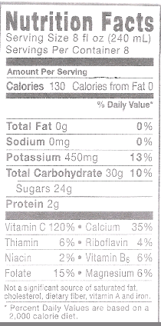
  The secret to carb counting
  1. Note the serving size
  2. Read the “Total Carbohydrate”
T

Slide 20
Many resources for carbs in food: a quick comprehensive one is Calorie King, available in book stores and on line.
For school: Can obtain school menu information from cafeteria manager, or ask parent to mark items in lunch from home. Best to give insulin
prior to eating, but if the child is not a reliable eater, it can be given immediately after. Child should always eat with their class.

Slide 21
What about those pesky classroom snacks and parties????
First – let Mom and Dad know ahead of time. They can decide if the child can have the same food (I hope so) and how they would like to address insulin coverage.
We always encourage full participation in every way!! If that child didn’t have diabetes, no one would be concerned how much frosting is on that cupcake, so why now?????

Slide 22
The rest of the kids are getting insulin for all that sugar, so we just have to do the same!!!
Say we have a yellow cake mix cupcake with
chocolate fudge frosting = 54 grams carb.
If Emma gets 1 unit per 10 grams = 5.4 units, so we will round this to 5 units as her syringe only measures whole units. She can have her cupcake and eat it too!!!

Slide 23
FOOD:
CARB ~ 100%
PROTEIN minimal
FAT minimal
FUEL:
BLOOD
GLUCOSE

Slide 24
So we have covered the food, now what about the glucose number, what if it is 300????
We had the sliding scale, but if carb counting, we didn’t address that number, so some have a sliding scale on top of the insulin to carb ratio:
A chart telling them to add units to the food dose depending on the number.
Or we can give them a formula so they can practice more math!!

Slide 25
We use a “correction factor” or sensitivity to bring down a high number.
The formula is:
Current glucose – target divided by the sensitivity.
i.e.:
300-180/50 = 120/50 = 2.4 or 2 units.
This additional insulin is only to be given every 3 hours, where food insulin can be given anytime they eat.

Slide 26
Why????
The fast-acting insulins we use for “bolus” or to cover food and glucose levels have about a 3 hour effect, so we don’t want to “stack” it because eventually too many doses would hit at once and cause hypoglycemia. However, when used to cover food, it just covers food.
So at school:

Slide 27
They can get insulin for breakfast, and maybe a correction dose if not done at home, then usually again at lunch. If there is a snack, they may get food coverage, maybe not.
Sometimes they may get corrective doses. We get several calls each day, and we address them individually.

Slide 28
On injections: A long acting as a basal insulin and a rapid acting that is given as a bolus dose to take care of food and high numbers.
They can’t be mixed in the same syringe.
Can’t be skipped without the child then not feeling well, and high blood sugars do not feel well, unless they are used to high levels all the time, and we hope not!!

Slide 29
Hypoglycemia
Causes: Too little food for insulin dose
Activity
Stress
Illness
or It’s a Mystery!!!!!

Slide 30
Signs and Symptoms:
Shaky
Sweaty
Spacy
Starving
Grouchy
Feels high
Can’t Concentrate

Slide 31
They need to have a buddy take them to the nurse to have the glucose checked. Even if not >70, treat!!! For a mild episode: we use the rule of 15’s. Treat with 15 grams of rapid acting carbs, and wait 15 minutes. If still less than 70, treat again. If > 70, and meal is 30-45 minutes away, can wait for meal. If not, should have a snack to keep glucose up. Can have granola bar, crackers, whatever the parents have provided.
Sometimes the child can be grouchy, not themselves. If they become lethargic or spacy, call the nurse. It is a good idea to have some cake gel available and squirt it in their mouth if they are able to swallow. Their glucose is low enough that the brain is not working right!!

Slide 32
Uh oh!!!
Now he’s on the floor! If the child is unconscious, having a seizure, or cannot swallow, this calls for Glucagon. This is an emergency injection of the hormone that is opposite of insulin. It makes the liver secrete extra glucose into the blood. Do not take time to check the glucose first! This is a totally safe injection that will not harm the child, it will only help. It will not work right away, and it will cause vomiting, so turn the child on the side to prevent aspiration. Any school employee willing to learn how may give this injection.

Slide 33
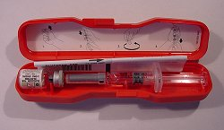
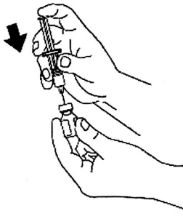
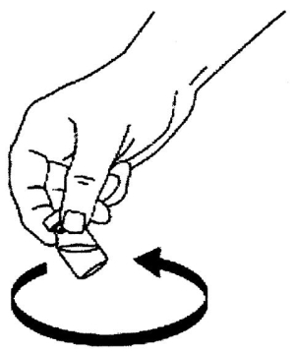
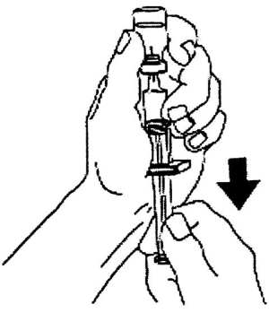
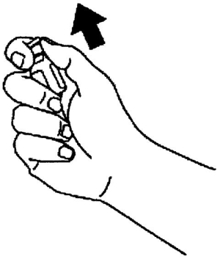
Diabetes Management:
Glucagon

Slide 34
In treating hypoglycemia, remember you are not treating the number but the symptoms!!!
Some people will be walking and talking with a glucose in the 20’s and some will have a seizure in the 50’s but next month, they will change places!
The key is to treat it while it is still mild. Be aware if a child has diabetes is with you, some are too shy to speak up!!

Slide 35
Hyperglycemia: Seems like that happens most of the time, doesn’t it? So when is it safe, when is it acceptable?
It’s safe, if there are ketones at small or less.
It’s never really what we want, but it is diabetes in a growing child. So we fix it and move on!! It can be “fixed” every 3 hours, with the corrective dose.

Slide 36
But…There are no “bad” blood sugars.
Be aware of words used and facial expressions.
Avoid blame: “What did you eat?”
Focus on how to correct it.
Focus on importance of checking glucose , not the number.

Slide 37
Causes:
Illness
Stress
Hormones, growth, puberty
Not enough insulin, or missed insulin
Over treated low or rebound
Pump or pump site problem
Or It’s a Mystery!!!

Slide 38
Signs and Symptoms:
Thirst
Frequent Urination
Fatigue
Grouchy
Blurry vision
Hungry or not
Feels low
Can’t concentrate (Sound familiar??)

Slide 39
So: If timing is right, insulin can be given, and back to class.
If glucose is >250 mg/dl, check for ketones.
If they are moderate of large, call diabetes provider, or whoever the medical orders designate. Usually, insulin is given, and back to class unless obvious significant symptoms….

Slide 40
Ketones
A fat burning waste product
Indicates a lack of insulin
Required test if BG is > 250mg/dl
Potentially DANGEROUS!
Can lead to DKA
Diabetic Ketoacidosis, this can be fatal!!
Notes:
Patients are taught to check for ketones when ill or whenever unexplained high BG levels appear. In Type 2, ketones are less likely to occur because of residual insulin production that suppresses the process of fat conversion to glucose.

Slide 41
Ketones – What are they???
Ketones are the byproduct of fat breakdown. We all make them overnight, because they are made when anyone is in a fasting state. When you are fasting, not taking in food that is not turned to glucose, you are fasting. Your body breaks down fat – to make glucose!!
So when a person with Type 1 diabetes doesn’t have enough glucose getting into their cells, because they don’t have enough insulin on board, they break down fat cells. However, without that insulin, that extra glucose just stays in the blood, making the blood sugar continue to rise. The cells continue to starve.

Slide 42
Signs and Symptoms:
Nausea, vomiting, abdominal pain
Breathing hard
Lethargy
Large urine or blood ketones
Call parents, 911 if at this point.
However, this is usually not the case at school.

Slide 43
Diet:
Past:
ADA diets: Counted calories
Used exchange system, could have so many carbs, proteins, fats in a day, and they were divided up between meals and snacks.
Now: for the Children: We stress Healthy balanced age appropriate meals and snacks. There are no specific restrictions or requirements. We provide general guidelines. As we teach primarily carb counting, our families know how to cover those high carb sugary treats on special occasions.

Slide 44
I personally like to tell the families to take diabetes out of the food discussions. They should have a healthy balanced age appropriate diet. Treats are ok sometimes for everyone, they are not ok every day for anyone, with or without diabetes!!!
Unfortunately, we still have the food police everywhere that scrutinize what the children are eating, telling them what they can and can’t eat. Really the only thing they can’t eat is poison or cookies – made with poison.

Slide 45
Why the change???
On the old system, it was believed that sugar raised blood sugar. It does, but it is really anything carbohydrate that raises blood sugar, not just sugar.
If you restrict or take something away from a child, what do they do?? They find a way to sneak it! So the old way promoted a lot of sneaking of food, and a lot of eating disorders among children with diabetes.

Slide 46
Exercise
Children and adolescents with Type 1 DM should adhere to the CDC and American Academy of Sports Medicine recommendations of minimum of 30-60 min of moderate physical activity daily.

Slide 47


Slide 48
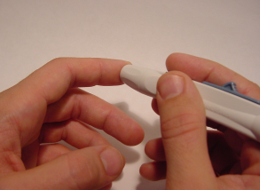
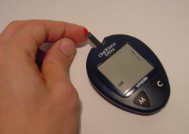
Diabetes Management:
Blood Glucose Testing
Tools:
  Glucose meter
  Glucose test strips
  Lancet (with lancet device)

Slide 49
Diabetes Management:
Blood Glucose Testing
Use glucose reading to determine:
  Insulin (injection or pump)
  Whether intervention is required
  Whether exercise or sleep are safe

Slide 50

BG Testing
Before meals
Feeling low
Feeling high or sick
Before bed
As much as 10 times per day!
102
Notes:
Skipped tests could be related to an unrecognized BG problem.

Slide 51
Goal: To maintain glucose as close to target range as possible.
Insulin doses and adjustment
To help the child participate in problem solve as age-appropriate, to prevent or treat high or low.
To decrease risk of long term complications

Slide 52
There are many meters out there. Most are very user friendly. Meters are inexpensive, but the strips are expensive, about $1 each!
To check, clean and dry fingers!!
Let child choose finger, lance, will need to “milk” the finger, drop blood onto strip, or on edge of strip, cover whole “window” or listen for beep.
Usual wait time is 5 seconds. It is a good idea to look at the meter for the result, even for those older ones who are just telling you the number.

Slide 53
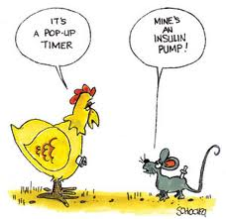

Slide 54
CSII
C ontinuous
S ubcutaneous
I insulin
I infusion

Slide 55
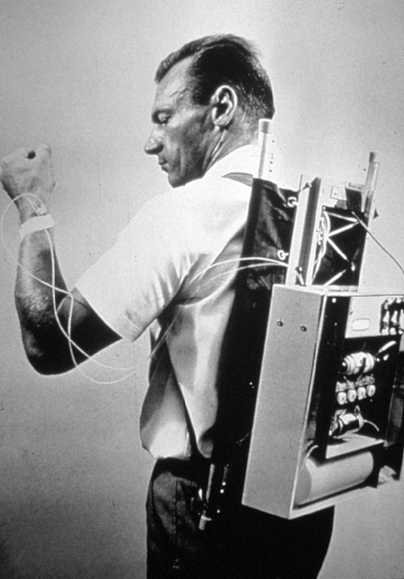
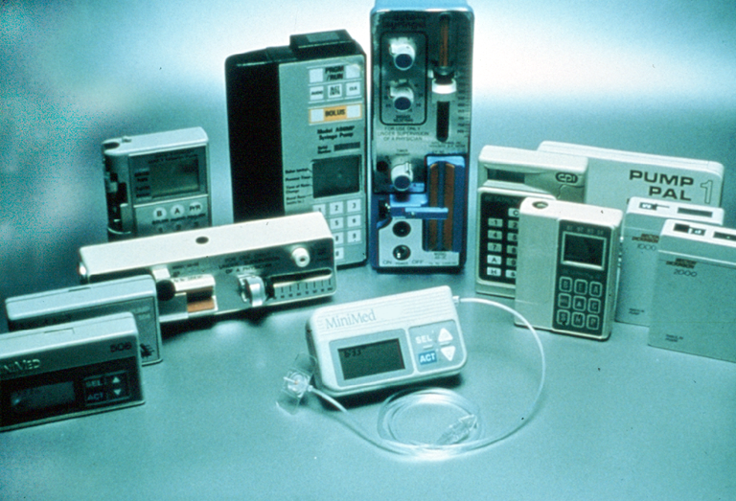

Slide 56
CSII Benefits
Potential to improve blood glucose control
Decreases incidence and progression of complications
Provides precise dosage delivery
Can adjust for hormonal changes in glucose levels
Improves control during exercise
Notes:
Exercising muscles need glucose. Glucose used up by muscle needs to be replaced from the available blood glucose. This can lead to hypoglycemia during and after exercise.

Slide 57
CSII Benefits
Decreases hypoglycemia
Increases flexibility in lifestyle:
Sleeping in
Eating with friends
Improves control for preconception and pregnancy
Notes:
Teens: None of us expects to have our teens pregnant, but unplanned pregnancies occur.
Improved control should be a discussion/counseling issue for future planning.

Slide 58
Simulates normal insulin delivery
Pump automatically delivers programmed basal
User delivers a specific insulin dose (bolus) when food (carbohydrate) is eaten or bg is high
The user may increase, decrease, or stop insulin delivery as situations demand
Pumper learns to “think like a pancreas”
Notes:
There is no long acting insulin involved since the pump only uses fast-acting insulin. Students on long-acting insulin (non-pumpers) have to worry about peak actions of the LA, to prevent low BG.

Slide 59
Pump Facts
Pager sized “Mini-computer”
Pre-programmed insulin delivery
Uses an cartridge and infusion set
Short-acting or fast acting insulin only
No surgery necessary
Glucose levels are not measured by pump

Slide 60

Pump Myths
Easy, no more injections …EVER!
Less time consuming
Less BG monitoring
Perfect blood glucose
No complications
Hospital stay required
Surgical procedure needed
Notes:
The use of a pump should be for the right reasons. Expectations need to be realistic. A pump is a management tool, not a cure for diabetes.

Slide 61
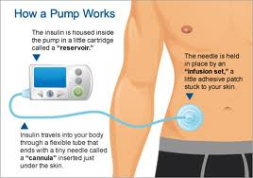

Slide 62
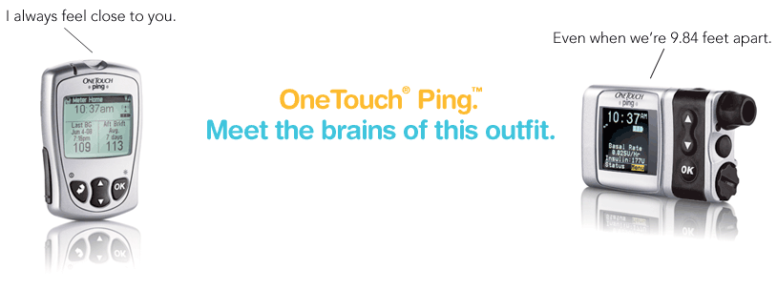
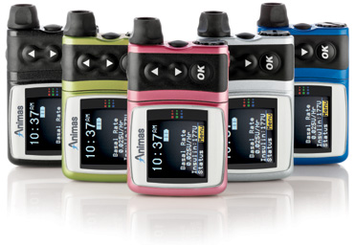
Animas Ping

Slide 63
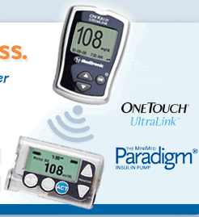
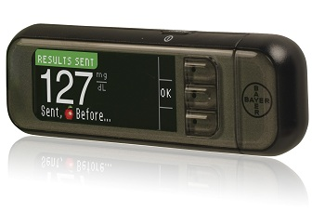
MiniMed Paradigm/Revel/530g
5xx/ 7xx

Slide 64
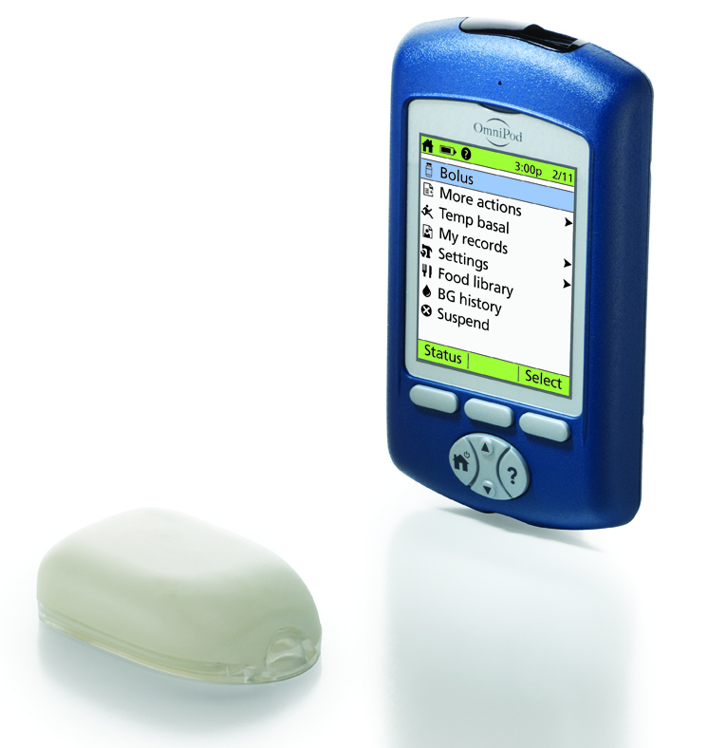
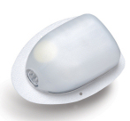
OmniPod

Slide 65
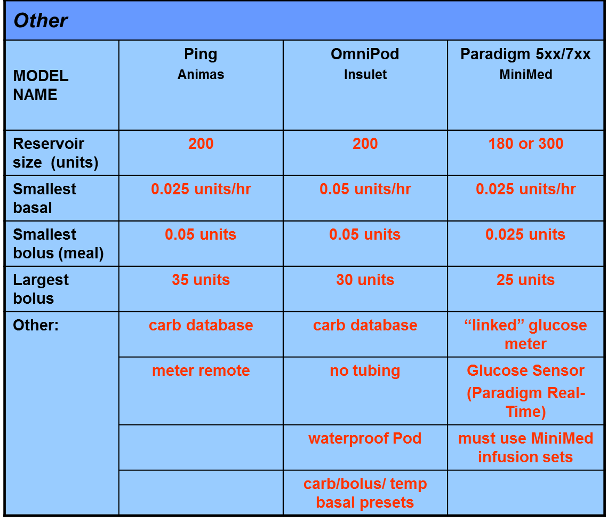

Slide 66
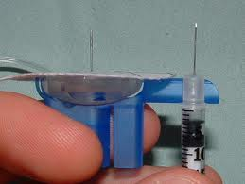

Slide 67
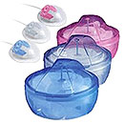

Slide 68


Slide 69
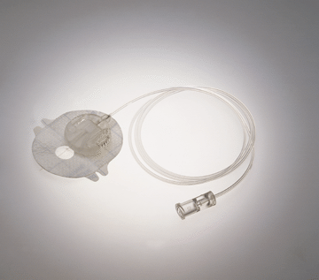
Insulin pump infusion set

Slide 70
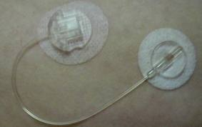

Slide 71
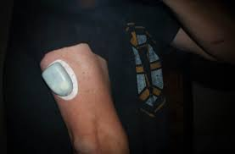

Slide 72

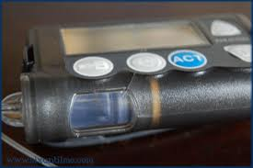

Slide 73
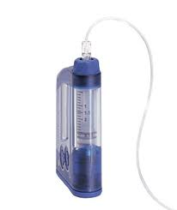
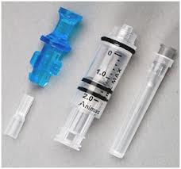

Slide 74
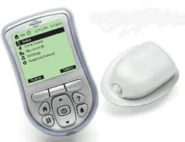


Slide 75
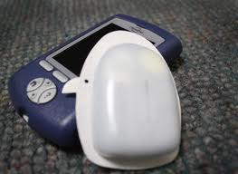
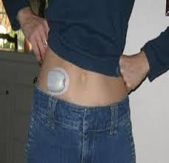

Slide 76
What’s in an Insulin Dose ?
Bolus dose includes:
BG
Carbohydrates
Correction Factor (insulin sensitivity)

Slide 77
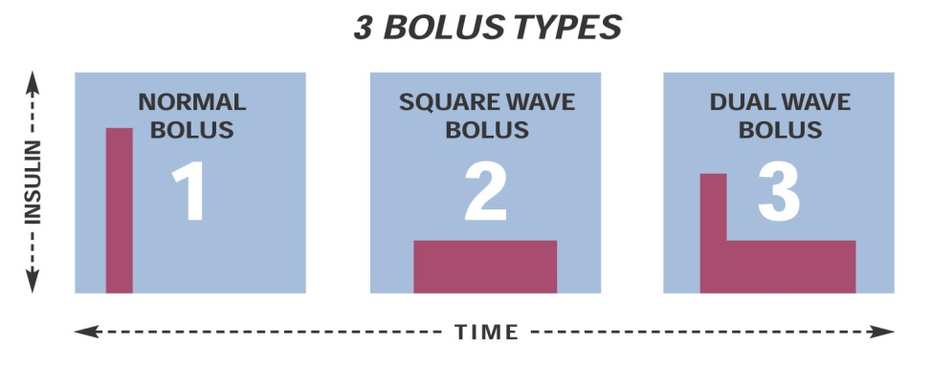
Normal Bolus
NORMAL
BOLUS
1
3 BOLUS TYPES
Delivers a specific dose of insulin over a short period of time
Commonly used for everyday meals and snacks
Used to correct a high blood glucose
SQUARE WAVE
BOLUS
DUAL WAVE
BOLUS
2
3
Notes:
The normal bolus delivers an immediate food bolus or correction bolus.
It can be delivered at any time, except during another normal bolus delivery.
During a normal bolus, most insulin pump features are disabled until all of the bolus has been delivered; however, the Suspend function and the Status screen are always available.
A normal bolus can be used to cover the carbohydrate content of a meal or snack and/or to correct a blood glucose that is higher than the target chosen for your patient.

Slide 78
Square Wave Bolus
Delivers an even bolus dose over a 30-minute to
8-hour time span
Can be used for food that takes longer to digest
3 BOLUS TYPES
NORMAL
BOLUS
SQUARE WAVE
BOLUS
DUAL WAVE
BOLUS
1
2
3
Notes:
FOLLOW TEXT ON SLIDE
NOTE: During delivery of a square wave bolus, the following insulin pump functions are not available:
Changing the maximum bolus amount
Disabling or delivering dual and square wave boluses
Conducting a fixed prime
Rewind
Changing the active insulin time
Running a self-test
Accessing the User Settings Menu
All other insulin pump functions are available during the square wave bolus.

Slide 79
Dual Wave Bolus
Delivers a bolus dose that is divided up to deliver part now and part over time
Used for high fat food or a food that an individual knows may keep the glucose up longer than usual

Slide 80
Bolus Wizard® Calculator Benefits
Reduces math errors by calculating meal and correction doses with customized settings based on each individual’s insulin requirements. Patients no longer need to calculate complex correction and carbohydrate doses
The active insulin calculation can prevent insulin stacking or over correcting for high glucose levels
Decreases the number of correction boluses required for post meal corrections
Notes:
The Bolus Wizard® calculator:
Reduces math errors—No need for the patient to calculate complex corrections and carbohydrate ratios. The Bolus Wizard calculator can do the math.
Decreases the number of correction boluses required—Using a bolus estimator has been shown to reduce the need for postmeal correction boluses.¹ This means the Bolus Wizard calculator can help to more easily and accurately match insulin delivery to the body’s needs throughout the day.
Lowers the entry error rate—With the Paradigm Link® Blood Glucose Monitor, powered by BD Logic® technology, the blood glucose (BG) value is sent directly to the insulin pump. This automatic step eliminates the risk of manually entering the wrong BG number.
Prevents insulin stacking—One of the most common bolusing errors is to overcorrect for a postmeal rise in BG. Overcorrection can occur when the amount of insulin still active in the body is not properly taken into consideration. When BG is above target, the Bolus Wizard calculator automatically takes into account the amount of active insulin still in the body. This helps avoid hypoglycemia resulting from too much insulin.
Reference: 1. Gross T, Kayne D, King A, et al. A bolus calculator is an effective means of controlling postprandial glycemia in patients on insulin pump therapy. Diabetes Technol Ther. 2003;5:365-369.
BD Logic® is a registered trademark of Becton, Dickinson and Company.

Slide 81



Programming the Bolus Wizard® Calculator
Setting Carbohydrate Ratios
Edit Settings
Wizard On
Carb Units: Grams
Carb Ratios: - - -
Grams: Carb ratio = number of carb grams covered by 1 Unit of insulin
Exchanges: Carb ratio = number of insulin Units needed to cover
1 (1.0) carb exchange
Insulin pump allows up to settings for different carb ratios at different times of the day
Carb Ratios:
Select Carb Ratios.
Press ACT.
Notes:
The Edit Settings screen will appear after a grams or exchanges setting is selected and ACT is pressed.
If grams are used as the carb Unit, then the carb ratio is the number of carb grams covered by 1 Unit of insulin. If exchanges are used as the carb unit, then the carb ratio is the number of insulin Units needed to cover one (1.0) carb exchange.
Because this ratio may vary throughout the day, your insulin pump allows you to set up to 8 settings.

Slide 82
Programming the Bolus Wizard® Calculator
Setting Carbohydrate Ratios
Edit Settings
Wizard On
Carb Units: Grams
Carb Ratios: - - -
Grams: Carb ratio = number of carb grams covered by 1 Unit of insulin
Exchanges: Carb ratio = number of insulin Units needed to cover
1 (1.0) carb exchange
Insulin pump allows up to 8 settings for different carb ratios at different times of the day
Carb Ratios:
Select Carb Ratios.
Press ACT.
Notes:
The Edit Settings screen will appear after a grams or exchanges setting is selected and ACT is pressed.
If grams are used as the carb Unit, then the carb ratio is the number of carb grams covered by 1 Unit of insulin. If exchanges are used as the carb unit, then the carb ratio is the number of insulin Units needed to cover one (1.0) carb exchange.
Because this ratio may vary throughout the day, your insulin pump allows you to set up to 8 settings.

Slide 83
Programming the Bolus Wizard® Calculator
Setting Carbohydrate Ratios
Edit Settings
Wizard On
Carb Units: Grams
Carb Ratios: - - -
Grams: Carb ratio = number of carb grams covered by 1 Unit of insulin
Exchanges: Carb ratio = number of insulin Units needed to cover
1 (1.0) carb exchange
Insulin pump allows up to 8 settings for different carb ratios at different times of the day
Carb Ratios:
Select Carb Ratios.
Press ACT.
Notes:
The Edit Settings screen will appear after a grams or exchanges setting is selected and ACT is pressed.
If grams are used as the carb Unit, then the carb ratio is the number of carb grams covered by 1 Unit of insulin. If exchanges are used as the carb unit, then the carb ratio is the number of insulin Units needed to cover one (1.0) carb exchange.
Because this ratio may vary throughout the day, your insulin pump allows you to set up to 8 settings.

Slide 84
Setting Blood Glucose Target Ranges
Programming the Bolus Wizard® Calculator
TARGET RANGE 1
12:00A mg / dL
100
–
100
If ranges are set <90 mg/dL or >140 mg/dL,
a warning screen will appear as a reminder.
Notes:
The blood glucose (BG) target settings allow the patient to set BG target levels. The patient may set up to 8 BG target levels each day.
To set a single BG target value instead of a range, set both the low and high BG range values to the same number.
Insulin pumps are sent from the factory with a default BG target range of
100 mg/dL to 100 mg/dL (5.6 mmol/L to 5.6 mmol/L).
If a patient sets BG targets outside the range of 90 mg/dL to 140 mg/dL
(5.0 mmol/L to 7.8 mmol/L), the insulin pump screen will display a warning that the target values, although acceptable, are outside the normal range.

Slide 85
Blood Glucose Below Target Range
Negative Correction Insulin Calculated
TARGET RANGE 1
12:00A mg / dL
80 – 100
Estimate Details
Est total: 3.7U
Food intake: 60 g
BG: 70
Food: 4.0U
Correction: -0.3U
Active ins: 0.0U
ACT to proceed,
ESC to back up
Est total:
60 = 4.0 U
15 g
Example
BG Below Programmed Range
BG: 70 mg/dL SF = 30
Carb: 60 g ICR = 15
Food:
Correction:
70 – 80 = -0.3 U
30
NOTE: Corrects to lowest end of range.
Notes:
If the current blood glucose (BG) value is below the BG target range, the Bolus Wizard® calculator will calculate a negative correction and subtract it from the food bolus.

Slide 86
Blood Glucose (BG) Within Target Range
No Correction Insulin Calculated
TARGET RANGE 1
12:00A mg / dL
80 – 100
Estimate Details
Est total: 4.0U
Food intake: 60 gm
BG: 82
Food: 4.0U
Correction: 0.0U
Active ins: 0.0U
ACT to proceed,
ESC to back up
Est total:
Example
BG Within Programmed Range
BG: 82 mg/dL SF = 30
Carbs: 60 g ICR = 15
60 = 4.0 U
15 g
Food:
Correction:
–
BG is between
80 and 100 mg dL
No correction calculated
Notes:
If the current blood glucose (BG) value is within the BG target range, the Bolus Wizard® calculator will calculate no correction insulin.

Slide 87
Blood Glucose (BG) Above Target Range
Positive Correction Insulin Calculated
TARGET RANGE 1
12:00A mg / dL
80 – 100
Estimate Details
Est total: 6.0U
Food intake: 60 gm
BG: 160
Food: 4.0U
Correction: 2.0U
Active ins: 0.0U
ACT to proceed,
ESC to back up
Est total:
60 = 4.0 U
15 g
Example
BG Above Programmed Range
BG: 160 mg/dL SF = 30
Carb: 60 g ICR = 15
Food:
Correction:
NOTE: Corrects to highest end of set range.
160 – 100 = +2.0 U
30
Notes:
If the current blood glucose value is above the target range, the Bolus Wizard® calculator will calculate a positive correction dose.

Slide 88
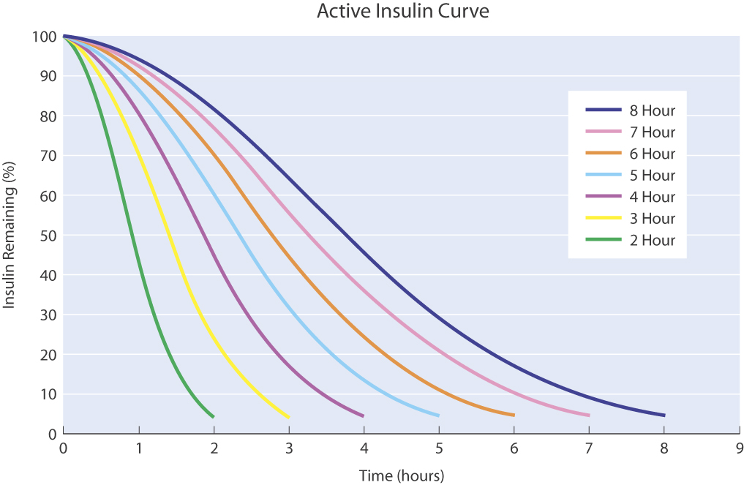
Adjustable Active Insulin Curves
Notes:
Active insulin is the bolus insulin that has already been delivered to the body but has not yet been used.
The Bolus Wizard® calculator feature considers the Active Insulin Time setting to determine the amount of active insulin that remains from prior boluses. This may help prevent hypoglycemia caused by overcorrecting for high blood glucose (BG).
The Bolus Wizard calculator feature automatically tracks active insulin and subtracts the appropriate amount when the BG is above the set target, based on your patient’s active insulin time.
The amount of active insulin estimated by the Bolus Wizard calculator will appear in the Estimate Details screen during the bolus programming steps.
The patient can choose to override the suggested Bolus Wizard calculator estimate and manually enter a different amount.
NOTE: The Bolus Wizard calculator feature cannot correctly determine the amount of active insulin in the body after a manual insulin injection. Your patient must wait at least 8 hours before relying on the Bolus Wizard calculator feature to calculate his/her active insulin.

Slide 89
Programming the Bolus Wizard® Calculator Active Insulin Time
Edit Settings
Wizard:
Carb Units:
Carb Ratios:
BG Units:
Sensitivity:
BG Target:
Active Insulin Time:
on
grams
15
mg/dL
50
100 – 100
6 hrs.
Active Insulin Time
Sensitivity:
6
hr
hr
Active Insulin Time
Select Active Insulin Time.
Press ACT.
Set number of hours.
Press ACT.
Notes:
In the Edit Settings screen, select Active Insulin Time and press ACT. Set the number of hours for the active insulin time and press ACT. The screen will return to the Edit Settings screen, where the new setting can be viewed.
The MiniMed Paradigm® REAL-Time System Insulin Pump is shipped from the factory with an active insulin time setting of 6 hours, which most closely matches the published scientific data on insulin pharmacodynamics. It is recommended that the 6-hour default be used; however, the Active Insulin Time setting can be adjusted in 1-hour increments from 2 to 8 hours.

Slide 90
To bolus:
Check glucose: If using linked meter, the glucose is transmitted into the pump.
Enter the carbs into the pump.

Slide 91
The pump will now calculate the dose of insulin. If the user agrees, he/she will now deliver the dose. If they don’t agree, they think they need more of less, they can increase or decrease the dose, and deliver. If there is “active” insulin on board from a previous dose, the pump will subtract that amount from the calculated amount.

Slide 92
Basal rates:
A pre-programmed amount that the pump is delivering around the clock. Increments can be as small as 0.025 units per hour.
Some pumps can deliver 48 different basal rates in 24 hours.

Slide 93
Basal Review Function
BASAL MENU
Set / Edit Temp Basal
Set / Edit Basal
Basal Review
Max Basal Rate
Patterns
Temp Basal Type
The Basal Review feature allows the daily basal delivery rates to be viewed
Basal rates should be reviewed on a regular basis and any time a change is made
A written record of the current basal rates should be available at all times
Basal Review
Insulin Rate (U/H)
Percent of Basal
Notes:
The Basal Review screen displays the basal insulin rates that are currently programmed for delivery from midnight (12:00 AM) to midnight (12:00 AM).
Patients should maintain a written record of their current basal rates.
Patients should be encouraged to review their daily basal rates on a regular basis and any time that a change has been made, and to compare these rates with their BG records. This activity will help patients work with their healthcare providers to determine their optimal daily insulin rate(s).

Slide 94
Temporary Basal Rate
BASAL MENU
Set / Edit Temp Basal
Set / Edit Basal
Basal Review
Max Basal Rate
Patterns
Temp Basal Type
Used to increase or decrease basal insulin during physical activity or during illness
A temporary basal rate will override all other basal rate programming for a set duration of time
Set for between 30 minutes and 24 hours
(up to maximum basal rate)
Can be set as
  Percent of basal: a percentage increase or decrease of the current basal rate
  Insulin rate: a basal rate in U/hr, independent of current basal rate
If a temporary basal rate is programmed, an open circle will appear next to the time on the Home screen, indicating a special mode
Set Edit Temp Basal
Insulin Rate (U/H)
Percent of Basal
Notes:
The Temp Basal Rate feature helps patients manage their BG levels during unusual short-term activities or conditions such as periods of illness or unplanned physical activity that is not part of their typical daily routine.
A Temp Basal Rate setting will override all other basal rates for a duration that can be set by the patient between 30 minutes and 24 hours. After the temporary basal delivery is completed, the insulin pump will return to the previously programmed basal rate.
The Temp Basal Rate feature can be set as:
Percent of basal: a percentage increase or decrease of the current basal rate
Insulin rate: a fixed basal rate in U/hr, independent of current basal rate
The temporary basal rate cannot exceed the maximum basal rate.
An open circle will appear next to the time on the Home screen when a temporary basal rate is programmed.
Note: For more prolonged periods of increased or decreased activity, making use of the Patterns feature may be more appropriate.

Slide 95
Setting a Temporary Basal Rate
Insulin Rate
SET DURATION
0:30
Press UP button
to set duration
Temp
Notes:
When an insulin rate (U/hr) is selected, the Paradigm® REAL-Time System Insulin Pump will deliver the fixed amount for the duration as set.

Slide 96
Setting a Temporary Basal Rate
Percent of Basal Rate
SET TEMP BASAL %
Press UP or DOWN
button to set
percent amount
1:00
50%
Notes:
Patients may select either percent of basal or insulin rate as their Temporary Basal Rate setting, based on their preference.
Percent of basal refers to a percentage increase or decrease from the patient’s current basal rate (0% to 200%; the upper limit cannot exceed the maximum basal rate).
To set a temporary basal rate, the first step is to select the basal type; in this current example the type is percent of basal. The patient would then navigate through the screens to set the duration, entering the desired minutes or hours during which they would like the temporary basal rate to be delivered.
In the current example on this slide, the temporary basal selection would deliver 50% of the basal rate for 1 hour.

Slide 97
Patterns Feature
The Patterns feature allows customized basal rates to be programmed in order to meet the patient’s daily, weekly or monthly needs. This feature is useful in the following circumstances:
  Changes in sleep times (weekends, shift work)
  Different schedule during the week vs weekends
  High-activity or low-activity days vs typical day
  Monthly hormonal shifts in some women
Up to 3 different patterns can be set:
  Standard, A, or B
This feature must be turned On before it can be used
Open circles will appear next to the time in the Home screen when either pattern A or B is active
Notes:
The Patterns feature is an option for insulin pump users that allows customized basal rates to be programmed in order to meet the patient’s daily, weekly, or monthly lifestyle needs. Different basal patterns can be set to match circumstances such as:
Changes in time of sleep (weekends, shift work)
Different schedule during the week vs weekends
High-activity or low-activity days vs typical day
The Standard Pattern supports the patient’s typical day-to-day activity, and is the pattern that the insulin pump uses when the Patterns feature is turned Off. Two other patterns (A and B) can be set to support activity levels that are not a part of the patient’s normal daily routine.
The insulin pump is delivered from the factory with the Patterns feature turned Off. This feature must be turned On before it can be used.
An open circle will appear next to the time on the Home screen when either pattern A or B is active.

Slide 98
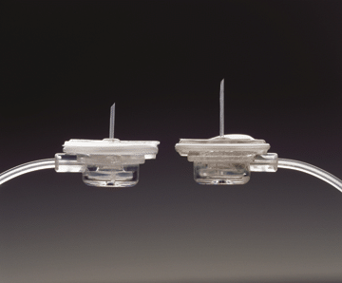
Infusion set cannulas

Slide 99
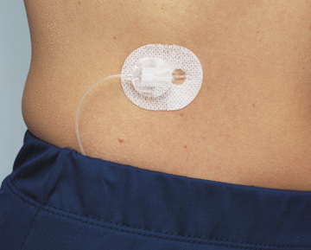
Connected

Slide 100
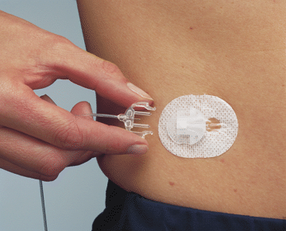
Disconnected

Slide 101
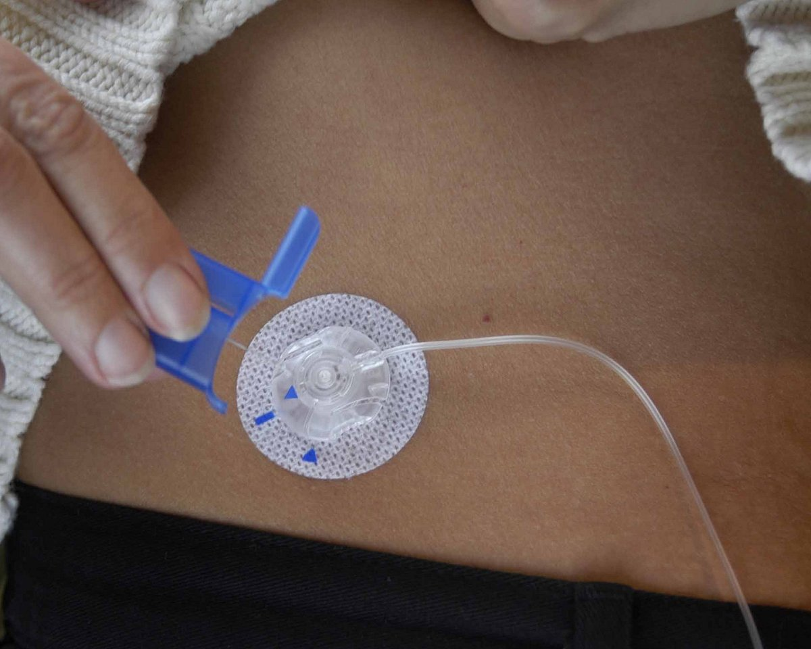
Infusion Set Challenges
Kinks
Blockage
Tape Adherence
Scar Tissue
Breakage
Infection
Poor Absorption

Slide 102
Psychosocial Issues
More difficult to hide diabetes from others
Being connected to a “machine”
Where to /wear the pump for prom night
Sleep-overs
Notes:
Most students do not want to be “different” from their friends. With improved BG control, increased energy, improved attentiveness for learning,more flexibility in lifestyle, improved sense of well-being and self-image, these issues are decreased. Once glucose and insulin requirements are regulated, few will give up their pump.

Slide 103
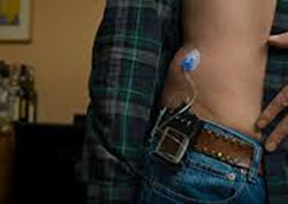
Infusion set and pump

Slide 104
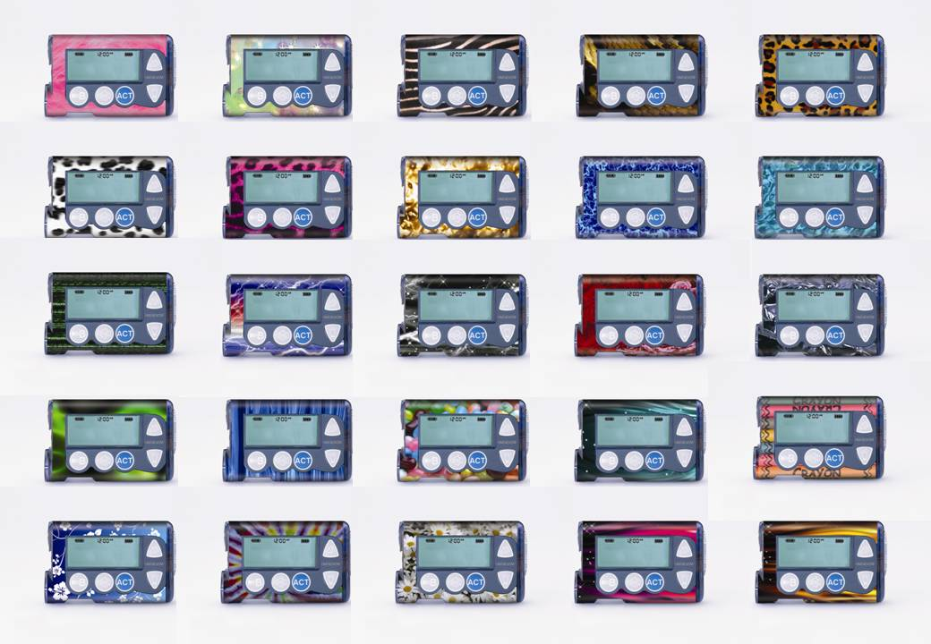

Slide 105
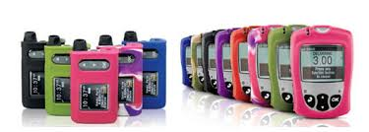

Slide 106




Slide 107

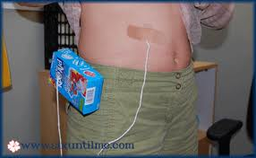


Slide 108




Slide 109



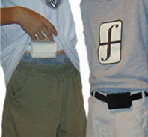
http://uniaccs.com

Slide 110
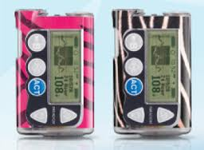

Slide 111
Challenges to Pump Therapy

Slide 112
Challenges to Pump Therapy
- Battery goes dead
- Pump malfunction
- Air bubbles in the tubing
*Disconnection Challenges*
- Disconnected too long
- Lost or forgotten pump
- Pump gets flushed or crushed!
- Safe storage

Slide 113

Challenges
Learning curve: weeks to months
May increase risk of DKA
(diabetic ketoacidosis, a
life-threatening emergency)
Possible weight gain
Requires frequent BG monitoring
Notes:
Parents/students receive several sessions of in-depth insulin pump management training.

Slide 114
Challenges
Potential site infections
Inconvenience in wearing
Self-image/modesty/dating
issues
Notes:
Anticipation and prevention of problems is addressed in training sessions.
Troubleshooting a problem is also part of the education process.

Slide 115
Challenges
Follow-up required
Cost
Troubleshooting problems during class
Notes:
Problems during class can be embarrassing, frustrating, and potentially disruptive. The student needs to have a plan for managing problems at school.

Slide 116
Tips for Success
Follow guidelines
Count carbs
BG tests
Adjustment for activity
Test for ketones when BG >250 x 2
Extra fluids for high BG
? Extra snack when active

Slide 117
Basic Pump Supply Kit
Infusion sets
Skin prepping solution/swabs
Pump cartridges
Insulin (✓ expiration date)
Pump batteries
Ketone strips
Blood Glucose test strips
Glucose tabs/ gel and Glucagon
Notes:
These can be kept in health or administrative office, or student locker/book bag

Slide 118
Care Plan for Pump
What? A part of DMMP or 504
Who?
School nurse
Teacher
Sports coach
Why?
Action plan for day-to-day troubleshooting
Guide for emergencies
Notes:
All students should have a plan in place.

Slide 119
Pumpers and parents say…
“…freedom!..to sleep in, eat at BD parties,”
“…more energy, less moody…”
“I have my daughter back!”
“His grades have gone up.”
“My pump is my friend.”
“So much easier to deal with those
‘raging hormones’!”
Notes:
Speaker: Add your own anecdotal notes about specific patients (no names) or parent responses.

Slide 120


Behavior Issues
From this…
Notes:
Is it diabetes, or something else?

Slide 121




To this…..

Slide 122
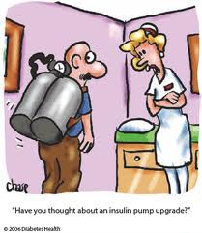

Slide 123
History of Glucose Monitoring
Closed Loop
Glucose Sensors
1999
Blood Glucose
Monitoring
1977
Urine Testing
1990s
Urine Tasting
1776

Slide 124
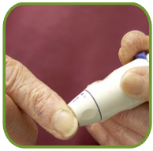


Current Monitoring Tools
6:00AM
9:00AM
12:00 PM
Blood Glucose Meter (Fingerstick)
HbA1c
Continuous Glucose Monitoring (CGM)
Notes:
Speaker’s Notes
EXPLAIN: Let’s face it. Testing for different things is part of your overall management strategy. You may have to have your lipid levels tested, your A1C levels, and your glucose levels.
And while some of these tests are performed by your healthcare provider, testing your glucose levels is something that you can—and have probably been instructed to—do. As such, glucose testing is part of your self-management responsibilities. In fact, this is something that you need to do every day, often several times each day.
The two most commonly used tools used to measure blood glucose levels are blood glucose meters (fingerstick) and continuous glucose monitoring (CGM).
Let’s start by taking a closer look at blood glucose meters.

Slide 126
Intensive Management and A1c
Intensive management attempts to decrease blood glucose variability
A1c test alone is not enough to measure good blood glucose control
Target Blood Glucose Range
Patient A – A1c of 7%
Patient B – A1c of 7%
Patient C – A1c of 7%
Illustrative purposes only
A1C Test – American Diabetes Association: http://www.diabetes.org/type-1-diabetes/a1c-test.jsp Sept 2007
Notes:
Glycemic excursions are not completely demonstrated by HbA1c values. Area under the curve is an important to minimize for intensive management.

Slide 127
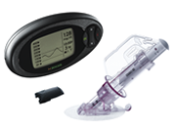
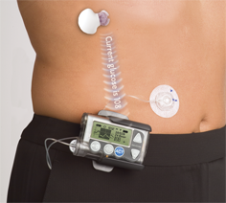
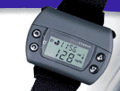
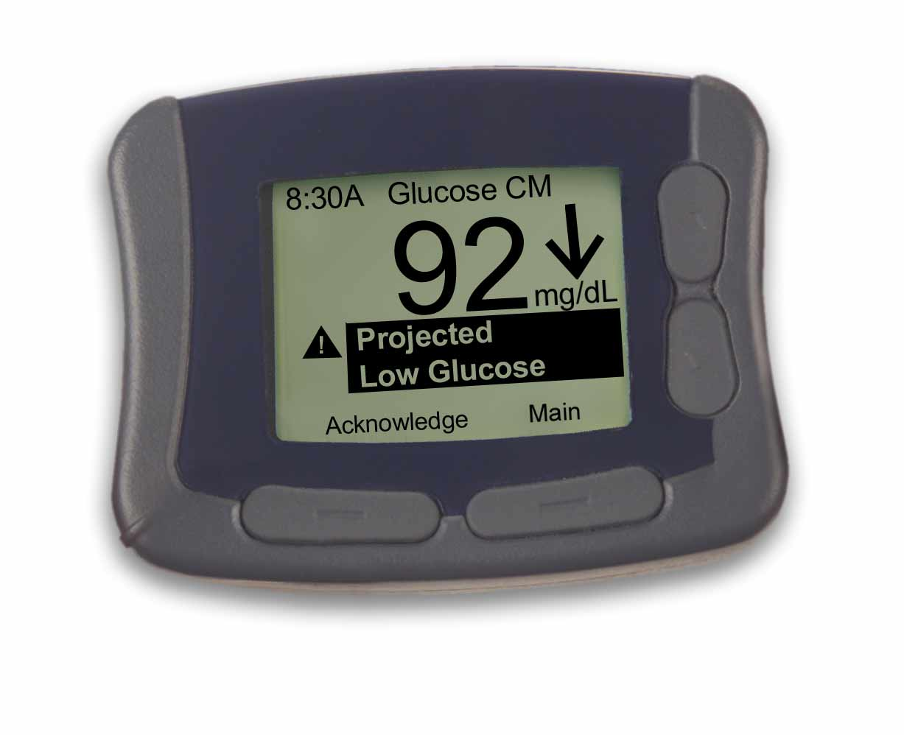
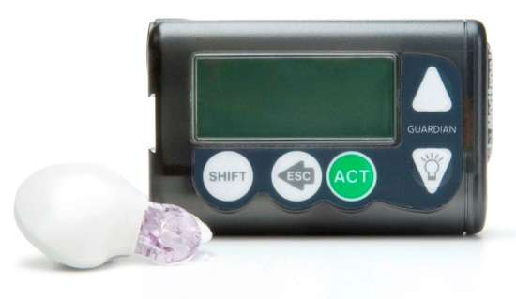
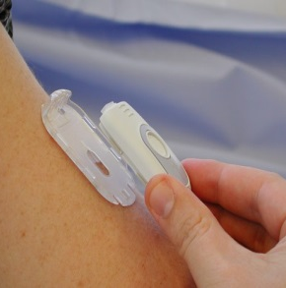
Continuous Glucose Monitoring (CGM)
Personal Products
GlucoWatch®
Seven™ System
MiniMed Paradigm® REAL-Time System
Guardian® RT Continuous Glucose Monitoring System
Abbott Navigator
GlucoWatch is a registered Trademark of Animas Corporation
Seven™ System is a registered Trademark of DexCom ™, Inc Corporation
Notes:
These are the only FDA approved Continuous Glucose sensing devices as of Sept 2007: Patient products include the Guardian RT by Medtronic, Paradigm RT by Medtronic, Seven System by DexCom and the GlucoWatch by Cigna/Animas. Professional products include CGMS System Gold by Medtronic.

Slide 128

Reveals Overall Pattern

Slide 129




Effect of Real-time Sensing
SA

Slide 130

Value of CGM
Ability to see interaction between medication, food choices, exercise, etc
Ability to view overnight trends
Download historical data
Improved communication with the Health Care Provider
Audible high and low blood sugar alerts
Better control and piece of mind
Priceless!

Slide 131
504 Plan, etc.
Rehabilitation Act of 1973, Section 504 of the Individuals with Disabilities Education Act of 1991
gives a child a right to have a 504 accommodation plan
any component of a child’s care plan must be allowed
school cannot deny this plan
Allows students with diabetes to receive
education from special ed if their disease
warrants it
Notes:
Refer to handout: Student Rights
504 Plan: gives child a right to have a 504 accommodation plan, any component of child’s care plan must be allowed, and the school cannot deny the plan.
Americans with Disabilities Act: prohibits discrimination in public places
IDEA: allows students with diabetes to receive educational help from Special Education, if their disease warrants it

Slide 132
504 Plan, etc.
Americans with Disabilities Act
Prohibits discrimination in
public places
Notes:
Refer to handout: Student Rights
504 Plan: gives child a right to have a 504 accommodation plan, any component of child’s care plan must be allowed, and the school cannot deny the plan.
Americans with Disabilities Act: prohibits discrimination in public places
IDEA: allows students with diabetes to receive educational help from Special Education, if their disease warrants it

Slide 133
504 Plan, etc.
Rehabilitation Act of 1973, Section 504 of the Individuals with Disabilities Education Act of 1991
Applies to all public and private schools that receive federal funding.
Americans with Disabilities Act
Schools must provide services to meet the needs of students with diabetes so that they may attend school in a medically safe environment and participate in the same activities as their peers.
Notes:
Refer to handout: Student Rights
504 Plan: gives child a right to have a 504 accommodation plan, any component of child’s care plan must be allowed, and the school cannot deny the plan.
Americans with Disabilities Act: prohibits discrimination in public places
IDEA: allows students with diabetes to receive educational help from Special Education, if their disease warrants it

Slide 134
IDEA of 1991
Students diabetes must adversely affect educational performance to the point that the student requires special education and related services. It must be shown that diabetes makes it more difficult for the child to learn. This may occur if the child has frequent hypo-or hyperglycemia that affects the child’s ability to concentrate or the student misses significant instruction time for diabetes care.

Slide 135
Schools are held by FERPA:
Family Education Rights and Privacy Act
Should disclose information about a student to those who must know in order to keep them safe. But not to anyone who has no need to know!!!!!
Health care providers are held by HIPAA.
Health Insurance Portability and Accountability Act

Slide 136
In NYS:
Each child with diabetes must be allowed to do blood glucose monitoring at any time within any place in the school, and may now be performed by anyone in the school setting. It is discrimination if this is denied.
All school personnel may be instructed in procedures to take in emergencies in the absence of licensed personnel, including the andminstration of Glucagon.

Slide 137
According to NYSED Memo from March 2012:
Only licensed health professionals can calculate insulin doses, administer insulin, program the pump, fill the reservoir and change the site. However, filling the reservoir and changing the site requires regular practice to maintain competence and is not recommended.

Slide 138
However, unlicensed school personnel trained by a licensed health professional may:
assist a self-directed student in programming the pump by verifying the math in calculating the carb count, or by reading the pump screen to the student verifying the number the student intended to put in.

Slide 139
More Regulations
Office of Civil Rights (OCR)
  children have the civil right to fair & appropriate education
  if any part of the child’s diabetes care is denied by the school system the parent has the right to file a complaint with the OCR
State of VA ruling: The “Loudoun Agreement”
  Requires the school to train at least 2 employees for 4 hours of diabetes care.
Notes:
OCR: children have the civil right to fair and appropriate education. If any part of the child’s diabetes care is denied by school system, parent has right to file complaint with OCR.
Loudoun Agreement: requires school to train at least 2 employees for 4 hours of diabetes care
OCR will use the above agreement for other problem counties in the US.

Slide 140
Parent Responsibility
Provide materials and equipment:
  Meter, BG strips, Lancets
  Ketone strips
  Supplies for treating problems: snacks, glucose tabs or gel, glucagon kit, insulin/syringe or insulin pen
  Pump supplies
Notes:
Parent and school personnel can negotiate a plan, if necessary.

Slide 141
Parent Responsibility
Diabetes Care Plan:
  Includes: frequency of BG testing and situations needing tests
  When to test ketones and actions for
  abnormal levels
  Basal rates, bolus ratios, correction amounts and administration times
  Meals and snacks, food content, amounts, timing
  Emergency phone numbers
Notes:
Sample handout of a plan

Slide 142
Parent Responsibility
  Symptoms and treatment for high and low blood glucose
  Information about diabetes, the pump, and training in performing tasks
Notes:
Note: many pump trainers/ territory sales reps are willing to schedule an appointment to review the pump with the school nurse or designated individual

Slide 143
School Responsibility
Immediate treatment for low BG with assistance from knowledgeable adults AND without requiring child to travel distances alone to seek treatment
Maintain and store supplies to treat
low BGs
Notes:
Handout “Letter to Teachers and Coaches” sample

Slide 144
School Responsibility
Adult and back-up adult trained to:
  Perform appropriate actions for BGs outside of target ranges cited in the Diabetes Care Plan
  Perform or assist fingerstick BG and record results
  Prepare and give glucagon
  Perform urine or blood ketone tests (if needed) and respond appropriately based on results

Slide 145
School Responsibility
Provide location of privacy during testing and insulin administration
Permission: for child to see medical personnel on request
  to eat snack anywhere to prevent low BG (class, school bus, recess, physical education)
  to use restroom and have access to water,
  to carry glucose tabs or gel

Slide 146
As the availability of school RNs decreases, the safety of children with diabetes in school also decreases. There are still schools that prohibit children from attending field trips, participate in sports, and even attend school because a nurse is not available.
Senate Bill 4473/Assembly Bill 4987
The School Diabetes Care Bill

Slide 147
Senate Bill 4473/Assembly Bill 4987
The School Diabetes Care Bill
This will allow non-medical school staff to volunteer to be trained by the school nurse to deliver diabetes care when the school nurse is not available. Many other states have already adopted similar regulations, and in NYS, day cares are already doing this.

Slide 148
This is NOT meant to replace nurses in the school. It will not be mandatory for any school staff. Nurses will not be liable for those they trained. This is to increase safety for children with diabetes while they are at school or school functions when a nurse can’t be available.
And for once: It is NOT an unfunded mandate!!!!!

Slide 149



Whats in the Future?

Slide 150
QUESTIONS?

