Slide 1
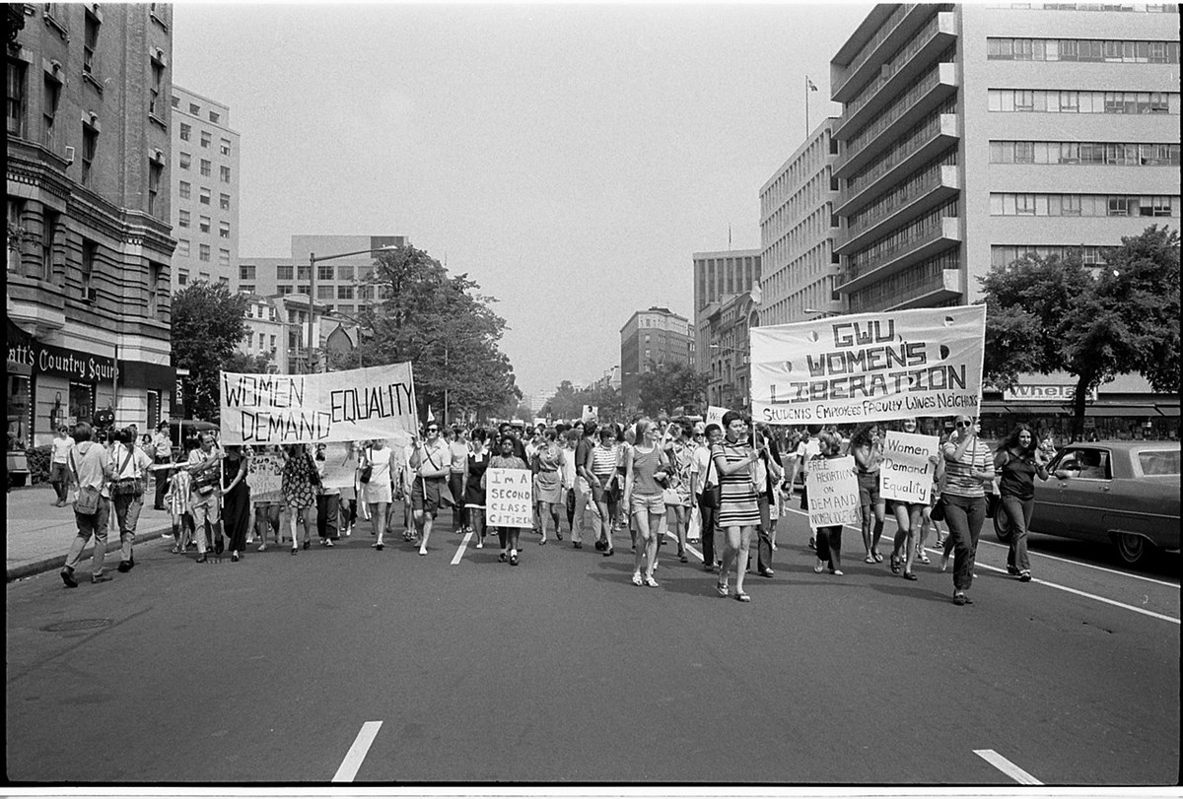
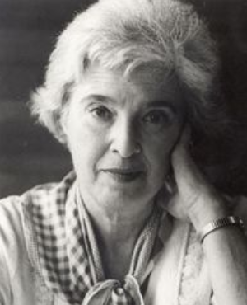
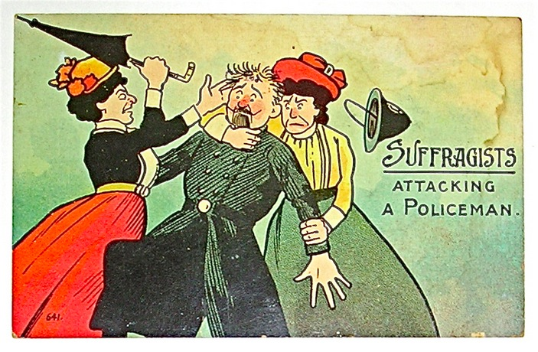

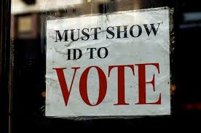
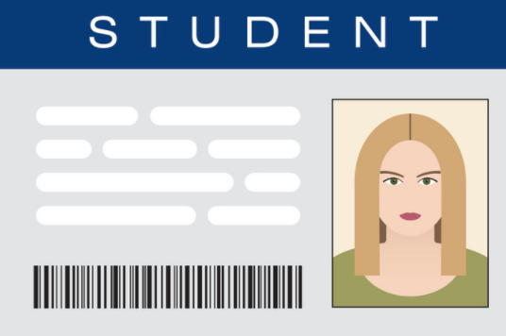
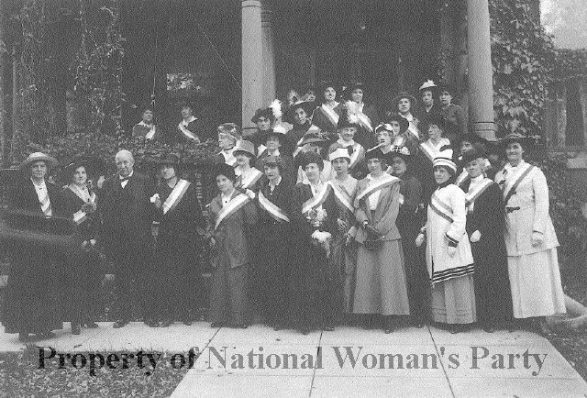
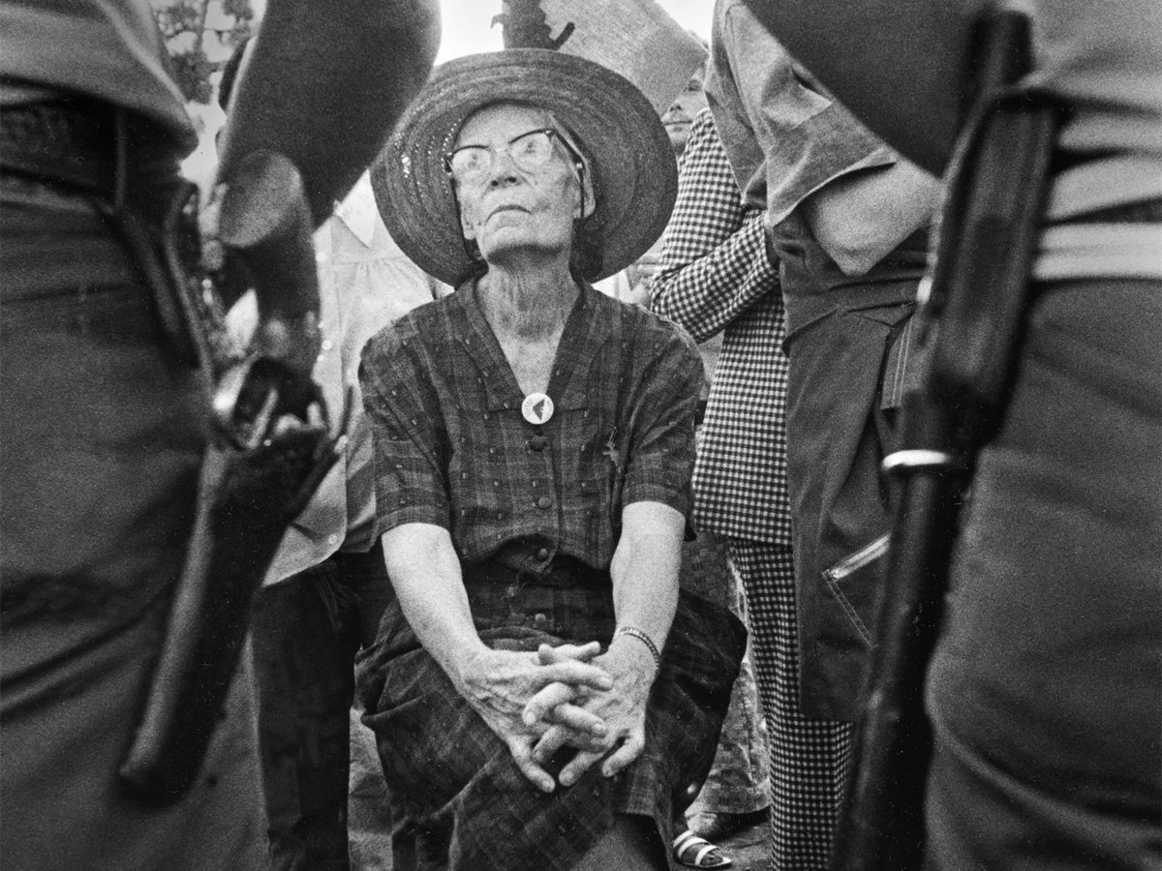
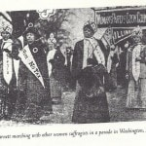
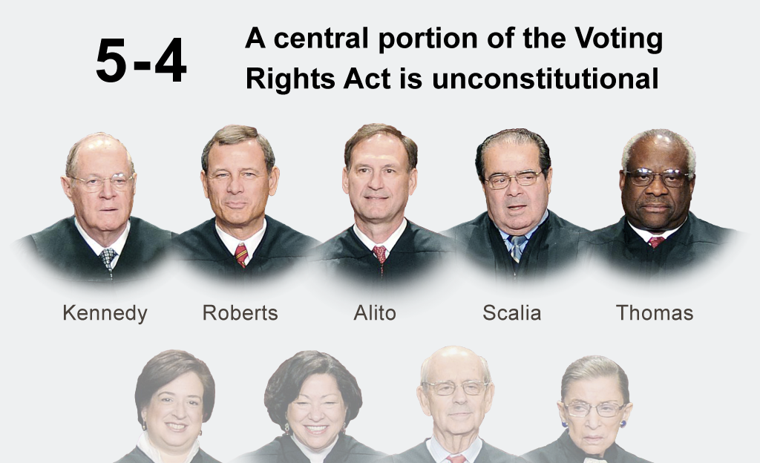
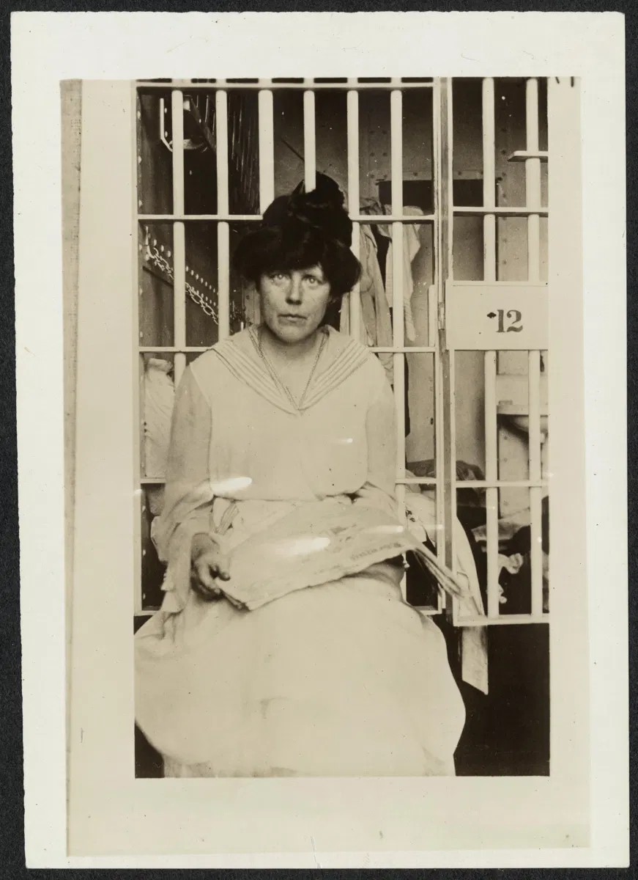
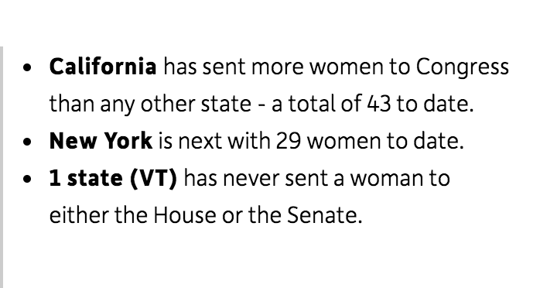
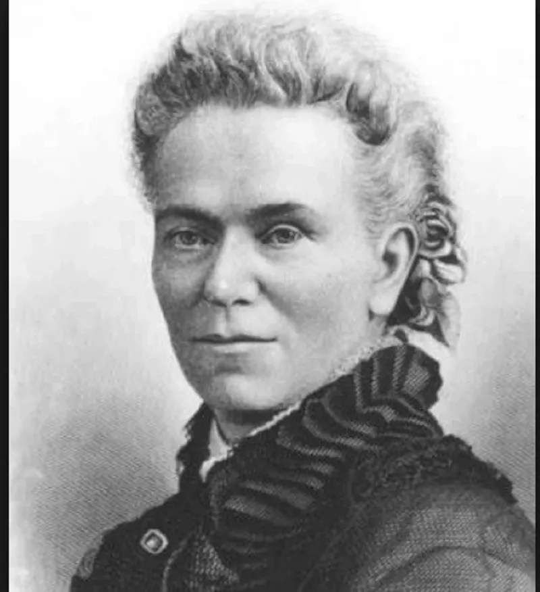
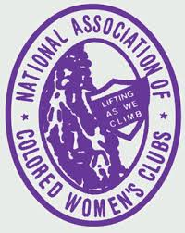
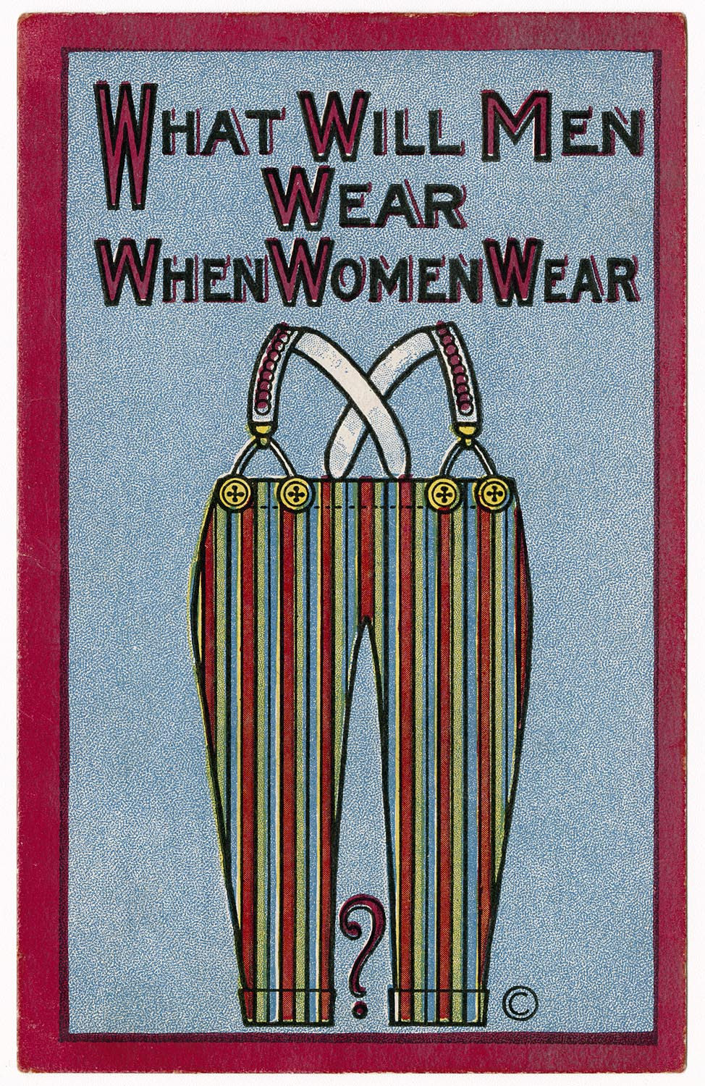
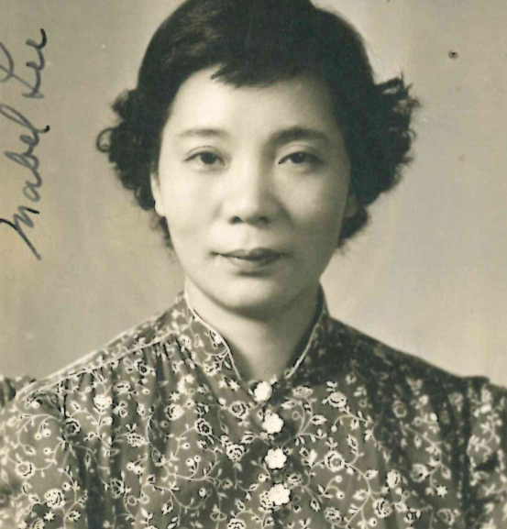
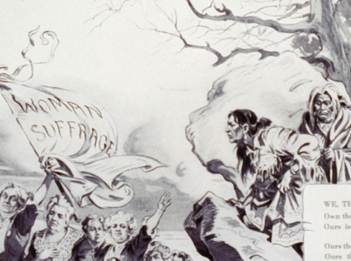
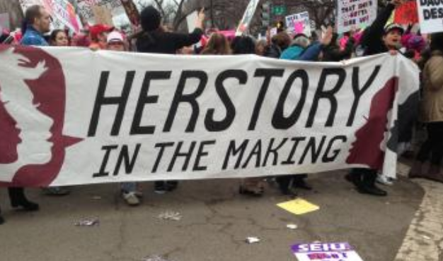
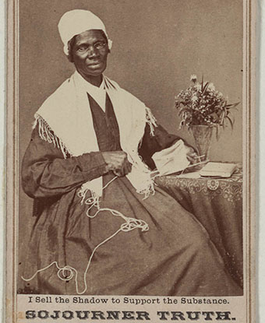
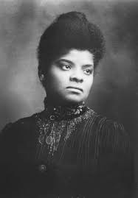
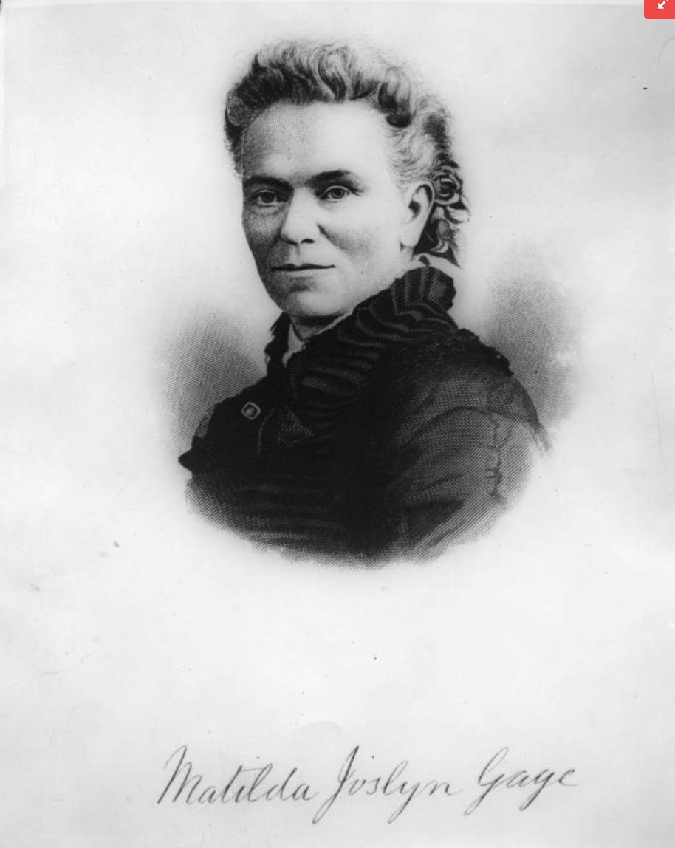
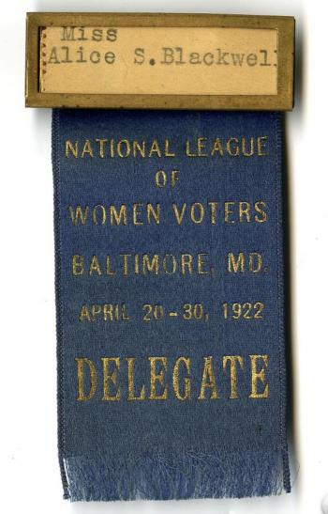
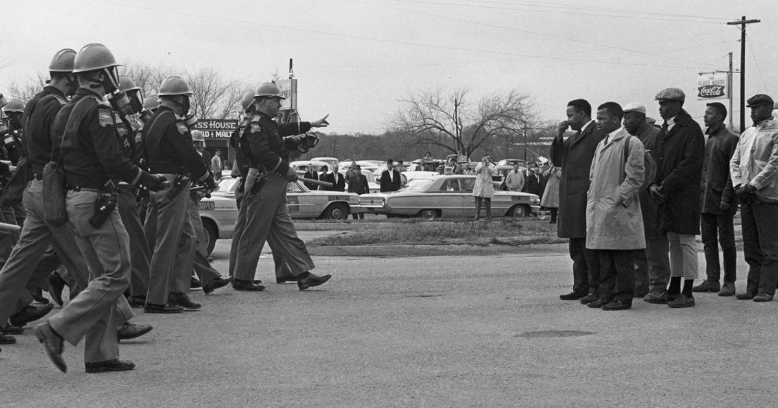
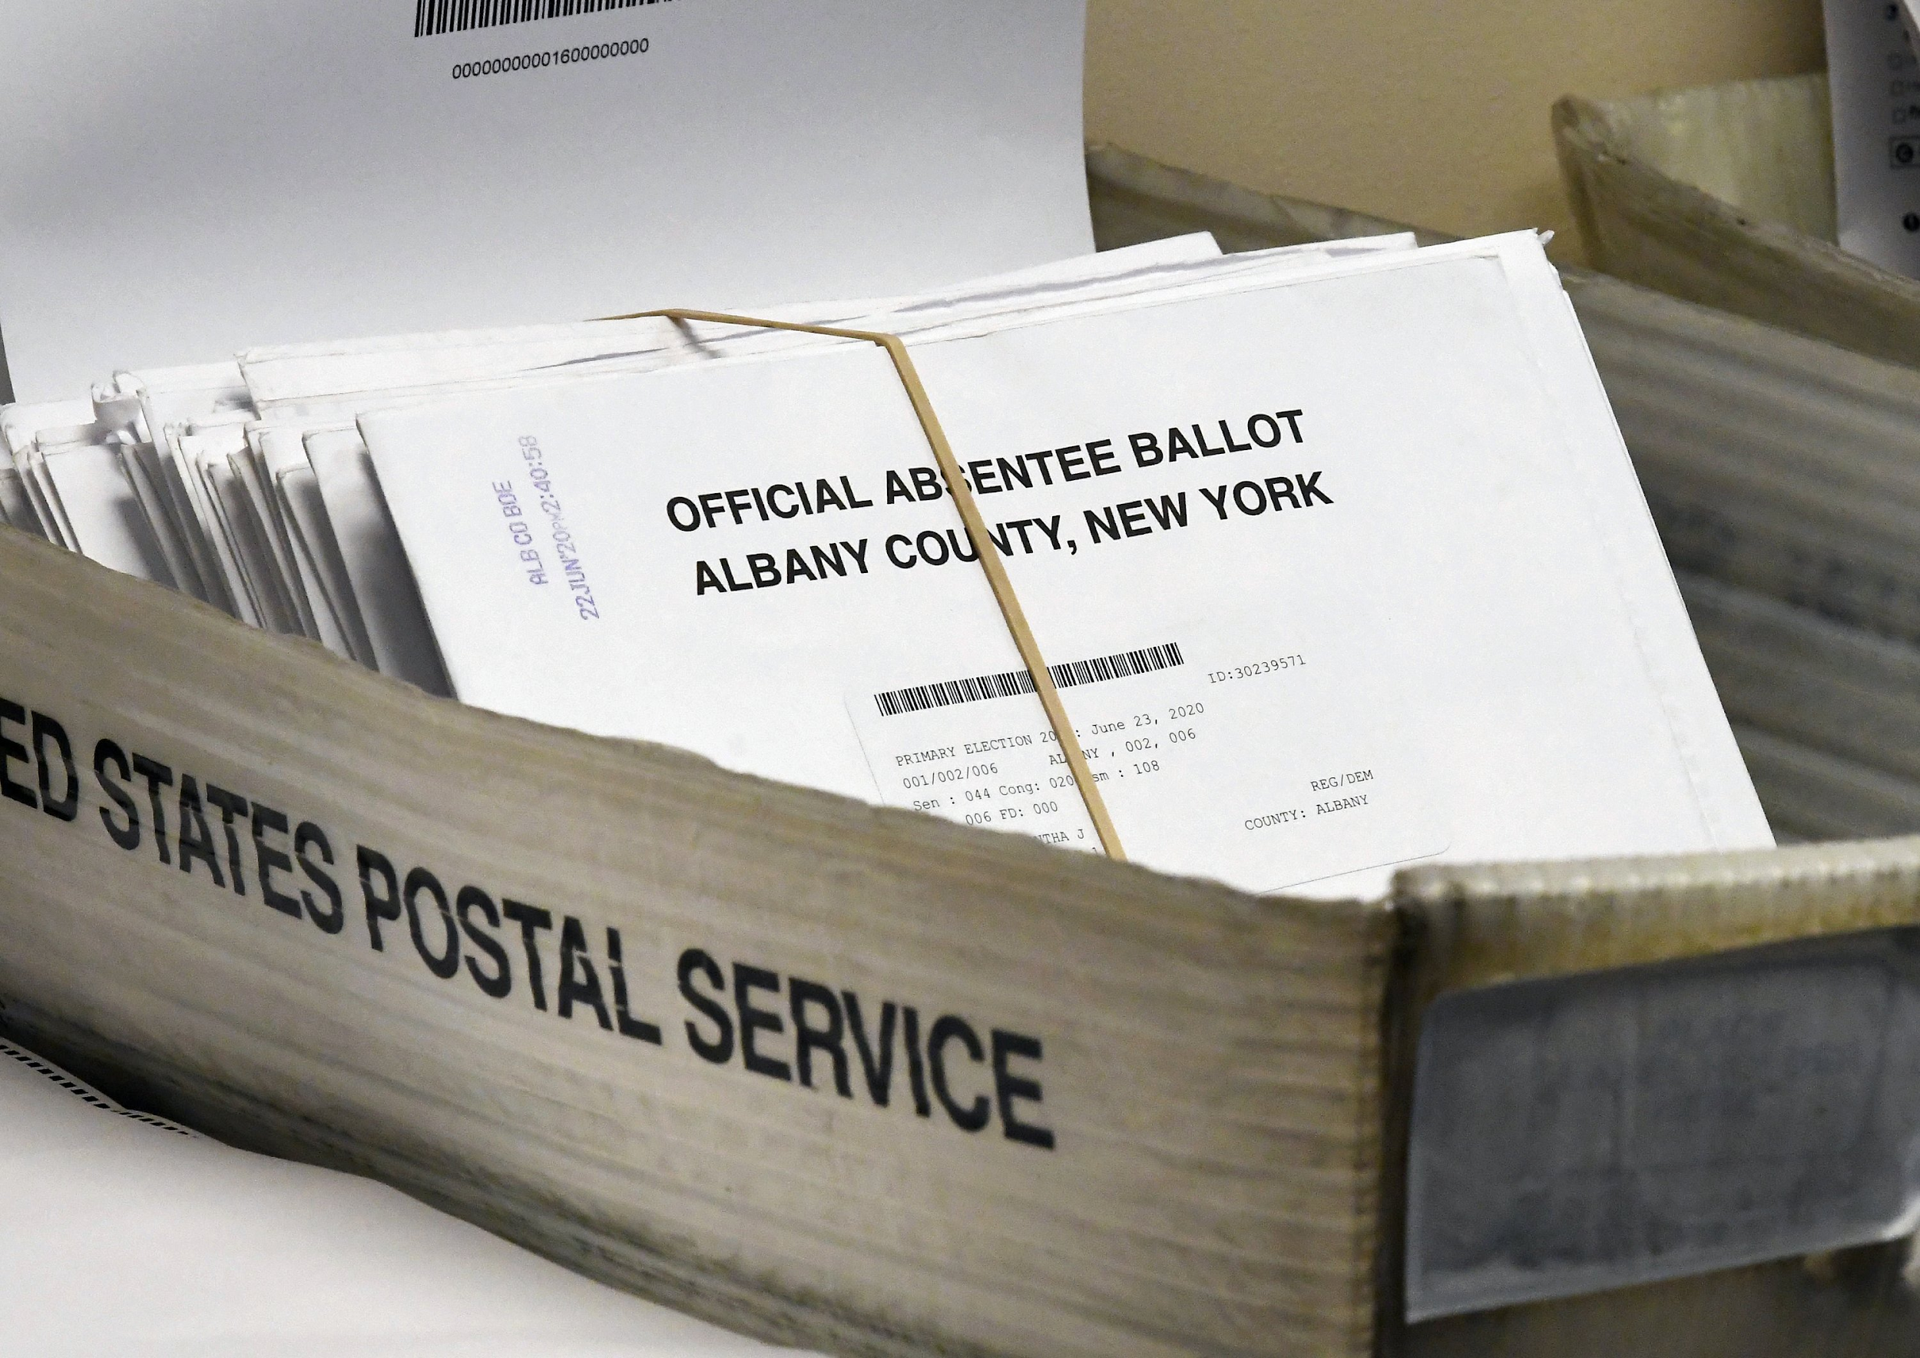
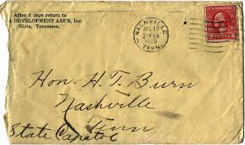
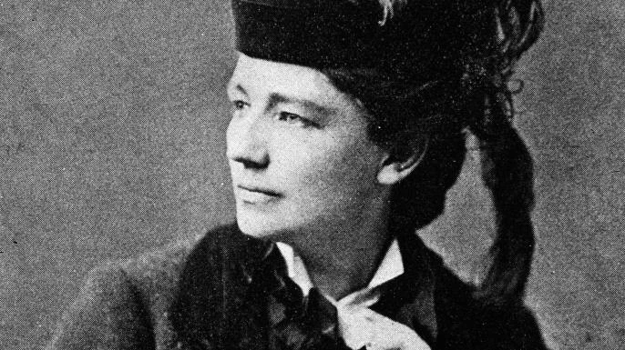
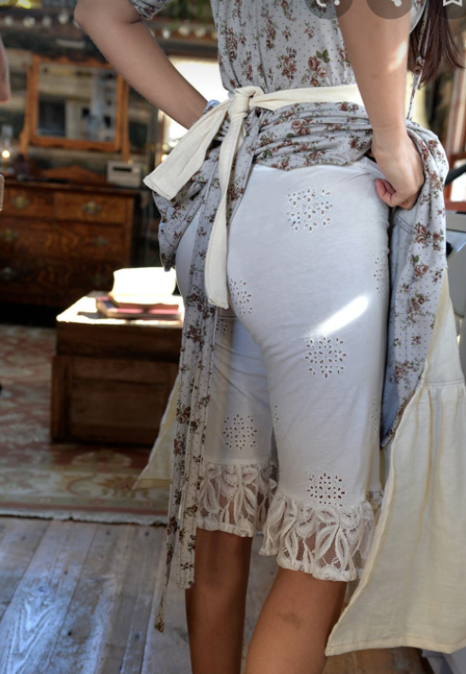
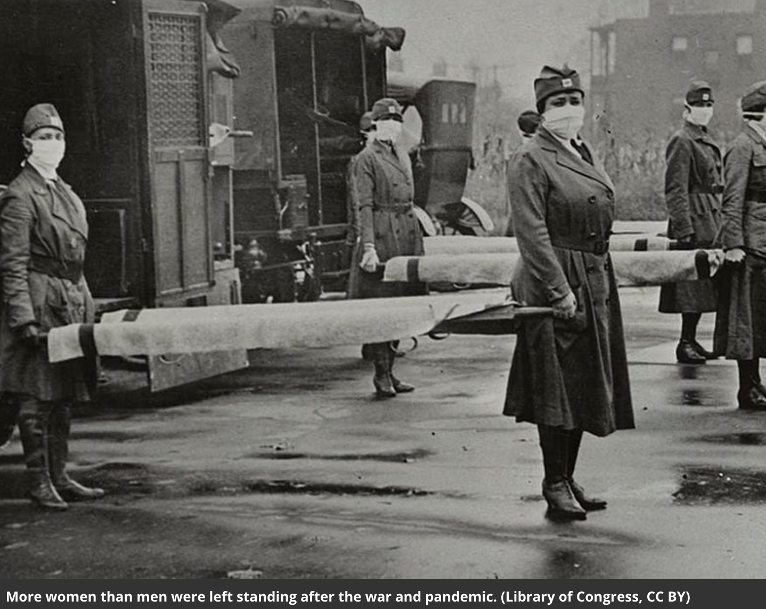

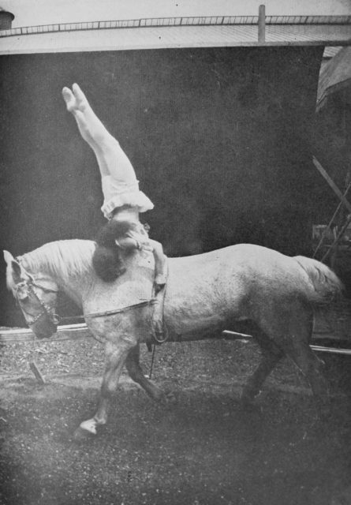
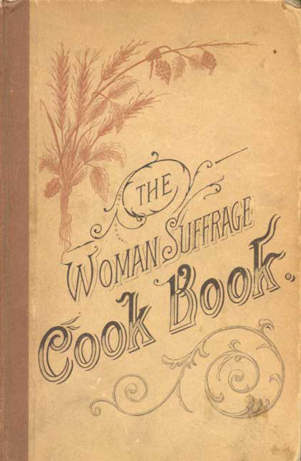
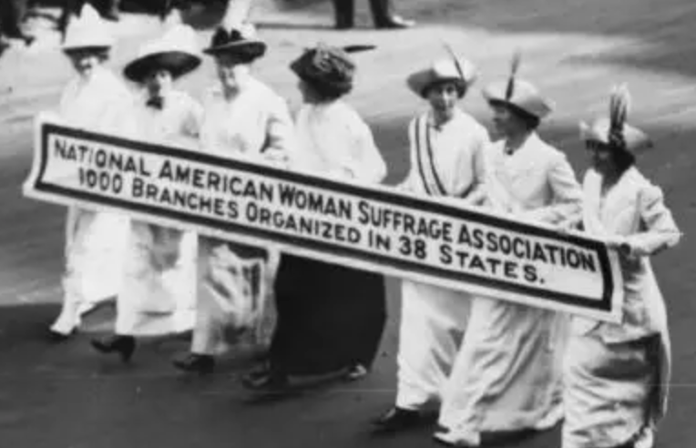
Welcome to
Voting Rights Awareness Days
-In Sisterhood and Solidarity, NYSUT Women
Day 1
Gender Equality
Day 2
Gerda Lerner
Day 3
Postcards
Day 4
Suppression
Day 5
Photo ID
Day 6
Voter ID Laws
Day 7
In Spanish
 |  |  | R
Day 8
Dorothy Day
Day 9
The March
Day 10
Voting Right Act
Day 11
Lucy Burns
Day 12
Representation
Day 13
Matilda Gage
Day 14 Lifting As We Climb
Day 15
The Antis
Day 16 Dr. Mabel Ping-Hua Lee
Day 17
THE IROQUOIS
Day 18 No Taxation Without Representation
Day 19
HerStory
Day 20 Sojourner Truth
Day 21
Ida B Wells
Day 22 League of Women Voters
Day 23
Selma March
Day 24
Absentee ballot
Day 25
“Be a good boy”
Day 26 Victoria Woodhull
Day 27
Bloomers
Day 28 A tragic pandemic
Day 29 Cookbook
Day 30 Circus
Day 31 Roots in Abolition Movement

Slide 2
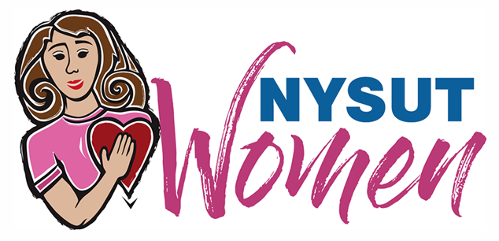
As we commemorate the centennial anniversary of women being granted the right to vote, we need to remember that “women” did not mean “all women.” To honor our suffragist sisters, we continue to fight for equality at the ballot box. Each day this month we will share facts meant to inspire action.
In Sisterhood and Solidarity, NYSUT Women
Voting Rights Awareness Day 1
A century after the ratification of the 19th Amendment, women are still advocating for their rights. This activism would be impossible without the power of the vote that enables women to have a say in the democracy in which they live. The 19th Amendment is a milestone in American history.
In the late 1960s and 1970s the Women's Liberation Movement rejected patriarchy and sought to bring more attention to issues of gender equality.
#NYSUTWomenVote2020
Learn more here: The 19th Amendment: A Crash Course - Women's Rights
Notes:
Rae is done!

Slide 3
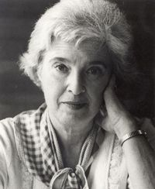
As we commemorate the centennial anniversary of women being granted the right to vote, we need to remember that “women” did not mean “all women.” To honor our suffragist sisters, we continue to fight for equality at the ballot box. Each day this month we will share facts meant to inspire action.
In Sisterhood and Solidarity, NYSUT Women
In Sisterhood
In Sisterhood and Solidarity, NYSUT Women
Voting Rights Awareness Day 2
“First of all, nobody gave us anything. It makes me furious when I hear that they gave us suffrage. Excuse me? It took 72 years of unrelenting, unbroken organizing grassroots effort to get women's suffrage. It took 113 years to get rid of child labor by law. It took similarly long periods of organized effort to accomplish any advance in social policy.”
~ Gerda Lerner
#NYSUTWomenVote2020
Every vote counts!
#NYSUTWomenVote2020
Learn more here: Gerda Lerner (Author of The Creation of Patriarchy)

Slide 4
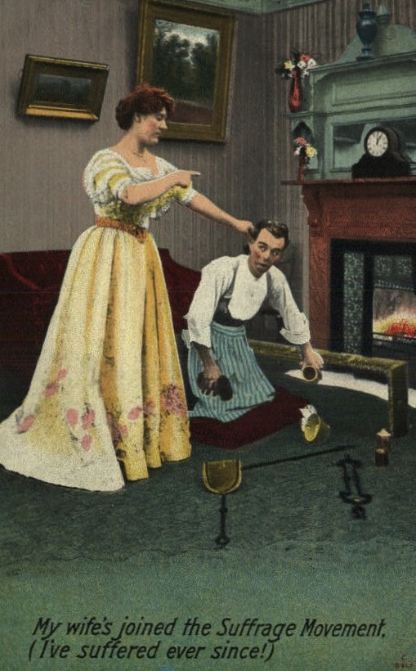
As we commemorate the centennial anniversary of women being granted the right to vote, we need to remember that “women” did not mean “all women.” To honor our suffragist sisters, we continue to fight for equality at the ballot box. Each day this month we will share facts meant to inspire action.
In Sisterhood and Solidarity, NYSUT Women
Voting Rights Awareness Day 3
“Between the 1890s and early 1900s, thousands of illustrations like these were produced and distributed around the United States and England, on postcards, in magazines and on public billboards. The message was that women’s rights were dangerous and letting women think for themselves could only end in a nightmarish society.”
#NYSUTWomenVote2020
Learn more here: The Posters That Warned Against "the Horrors of a World With Women's Rights"

Slide 5
As we commemorate the centennial anniversary of women being granted the right to vote, we need to remember that “women” did not mean “all women.” To honor our suffragist sisters, we continue to fight for equality at the ballot box. Each day this month we will share facts meant to inspire action.
In Sisterhood and Solidarity, NYSUT Women
Voting Rights Awareness Day 4
In 2008, we had the most diverse
electorate in U.S. history.
From 2011 to 2012, 27 measures were
passed or implemented in 19 states that
made it harder to vote.
#NYSUTWomenVote2020
Learn more here: Voting Rights

Slide 6
As we commemorate the centennial anniversary of women being granted the right to vote, we need to remember that “women” did not mean “all women.” To honor our suffragist sisters, we continue to fight for equality at the ballot box. Each day this month we will share facts meant to inspire action.
In Sisterhood and Solidarity, NYSUT Women
Voting Rights Awareness Day 5
•In South Carolina, 81,938 minority voters lack government-issued ID.
• Minority voters are 20 PERCENT MORE LIKELY to lack photo ID issued by the Department of Motor Vehicles than white voters.
#NYSUTWomenVote2020
Learn more here: Voting Rights

Slide 7
As we commemorate the centennial anniversary of women being granted the right to vote, we need to remember that “women” did not mean “all women.” To honor our suffragist sisters, we continue to fight for equality at the ballot box. Each day this month we will share facts meant to inspire action.
In Sisterhood and Solidarity, NYSUT Women
Voting Rights Awareness Day 6
In certain states, like Tennessee and Texas, you can vote using your concealed handgun license, but you are
not eligible to vote with your student ID.
#knowyourrights #votersuppression #voteridlaws
#NYSUTWomenVote2020
Learn more here: Voter ID Laws

Slide 8
As we commemorate the centennial anniversary of women being granted the right to vote, we need to remember that “women” did not mean “all women.” To honor our suffragist sisters, we continue to fight for equality at the ballot box. Each day this month we will share facts meant to inspire action.
In Sisterhood and Solidarity, NYSUT Women
Voting Rights Awareness Day 7
Spanish was also a language of suffrage. Armed with economic security and the political clout of long-established Spanish-speaking families, New Mexico’s Hispanic women represented a formidable political force. New Mexico’s vote to ratify would not have happened without the support of the Hispanic community or the advocacy work of Hispanic suffragists.
New Mexican Suffragists in 1915
Their story reminds us of the diversity of suffrage activism in the United States.
Their advocacy for the vote grew out of their insistence that
Spanish-Americans, as they called themselves, were equal citizens.
#NYSUTWomenVote2020
Learn more here:
Suffrage in Spanish: Hispanic Women and the Fight for the 19th Amendment in New Mexico

Slide 9
As we commemorate the centennial anniversary of women being granted the right to vote, we need to remember that “women” did not mean “all women.” To honor our suffragist sisters, we continue to fight for equality at the ballot box. Each day this month we will share facts meant to inspire action.
In Sisterhood and Solidarity, NYSUT Women
Voting Rights Awareness Day 8
“People say, what is the sense of our small effort?
They cannot see that we must lay one brick at a time, take one step at a time…
No one has a right to sit down and feel hopeless.
There is too much work to do.” ―Dorothy Day
Every vote counts.
#NYSUTWomenVote2020
An 'Intimate Portrait' Of Dorothy Day, The Catholic Activist With A Bohemian Past
Notes:
https://www.npr.org/2017/03/23/521220274/an-intimate-portrait-of-dorothy-day-the-catholic-activist-with-a-bohemian-past

Slide 10
As we commemorate the centennial anniversary of women being granted the right to vote, we need to remember that “women” did not mean “all women.” To honor our suffragist sisters, we continue to fight for equality at the ballot box. Each day this month we will share facts meant to inspire action.
In Sisterhood and Solidarity, NYSUT Women
Voting Rights Awareness Day 9
Women’s Suffrage March
March 3, 1913 - Washington D.C.
African American women were told to march at the back of the parade with the black procession.
As suffrage was still not welcome by many, protesters were pushed, shoved, tripped, spat upon and injured and the police “didn’t hold the mobs back.”
The daughter of formerly enslaved people, Mary Church Terrell was one of the founders of the National Association of Colored Women. While fighting against lynching and Jim Crow laws, Terrell advocated women’s suffrage. She spoke with authority because she represented “the only group in this country that has two such huge obstacles to surmount …both sex and race.”
Ida B. Wells-Barnett refused to march with an all-black delegation. She walked between two white supporters in the Illinois delegation.
The 22 founders of Delta Sigma Theta Sorority marched.
It was the only African American women’s organization to participate.
#NYSUTWomenVote2020
Learn more here: https://www.washingtonpost.com/blogs/she-the-people/wp/2013/03/03/despite-the-tremendous-risk-african-american-women-marched-for-suffrage-too/

Slide 11
As we commemorate the centennial anniversary of women being granted the right to vote, we need to remember that “women” did not mean “all women.” To honor our suffragist sisters, we continue to fight for equality at the ballot box. Each day this month we will share facts meant to inspire action.
In Sisterhood and Solidarity, NYSUT Women
Voting Rights Awareness Day 10
In 2013, the U.S. Supreme Court struck down
what had been called the “heart” of the
Voting Rights Act.
States no longer need “pre-clearance” from the federal DOJ
for new voting laws.
#NYSUTWomenVote2020
Learn more here: https://www.aclu.org/issues/voting-rights
Notes:
Add John Lewis Bill info?

Slide 12
As we commemorate the centennial anniversary of women being granted the right to vote, we need to remember that “women” did not mean “all women.” To honor our suffragist sisters, we continue to fight for equality at the ballot box. Each day this month we will share facts meant to inspire action. In Sisterhood and Solidarity, NYSUT Women
Voting Rights Awareness Day 11
It is unthinkable that a national government which represents women should ignore
the issue of the right of all women to political freedom." - Lucy Burns, 1913
Lucy Burns was arrested six times and served more jail time than any other suffragist in America.
Lucy organized 32 other suffragist prisoners by informing them of their rights. In retaliation, the 33 suffragists were beaten with clubs by 40 male guards and then refused medical attention. As the group's leader, Burns was singled out, and after beating her, guards chained her hands to the cell bars above her head for the night.
Lucy led a hunger strike and was force-fed by tubes up her nostril."
Widespread press coverage of these abuses, along with ongoing protests, strongly influenced the Wilson Administration who declared, in January 1918, that women's suffrage was urgently needed as a "war measure" and asked Congress to act.
#NYSUTWomenVote2020
Learn more here: https://www.facebook.com/amightygirl/photos/a.360833590619627/3129985140371111/?type=3&theater&ifg=1
Notes:
Should we edit to include the abuse she suffered with others while imprisoned?

Slide 13
As we commemorate the centennial anniversary of women being granted the right to vote, we need to remember that “women” did not mean “all women.” To honor our suffragist sisters, we continue to fight for equality at the ballot box. Each day this month we will share facts meant to inspire action.
In Sisterhood and Solidarity, NYSUT Women
Voting Rights Awareness Day 12
“There will never be complete equality until women themselves help
to make laws and elect lawmakers.” -Susan B. Anthony
Only 32.4 % of NYS legislators are women;
of them, 42% are women of color
Only 23.7% of members of Congress are women;
of them, 37.8% are women of color
Make your voice heard!
#NYSUTWomenVote2020
Learn more here: https://cawp.rutgers.edu/women-us-congress-2020
https://www.ncsl.org/legislators-staff/legislators/womens-legislative-network/women-in-state-legislatures-for-2020.aspx

Slide 14
As we commemorate the centennial anniversary of women being granted the right to vote, we need to remember that “women” did not mean “all women.” To honor our suffragist sisters, we continue to fight for equality at the ballot box. Each day this month we will share facts meant to inspire action. In Sisterhood and Solidarity, NYSUT Women
Voting Rights Awareness Day 13
WHO WAS MATILDA JOSLYN GAGE?
A suffragist that doesn’t fit the well-known narrative starting at Seneca Falls
and ending at the 19th amendment.
“The woman who was AHEAD of the women who were AHEAD of their time.” - Gloria Steinem
Notoriously argumentative, she was known for her ability “to detect and register any masculine deficiencies with phenomenal accuracy.” Matilda Joslyn Gage criticized the church for its role in the oppression of women. She offered her home to people escaping slavery when she was pregnant with her third child, facing thousands of dollars in fines and six months in jail for doing so. She saw the social, religious, economic, and political positions of the Iroquois Nation as far superior to her own, supported native treaty rights, recognized Native Nation sovereignty, and was honorarily adopted into the Wolf Clan of the Mohawk Nation.
She risked arrest by attempting to vote and by illegally presenting a Declaration of Rights of the Women of the United States (which she co-authored) at the nation’s centennial celebration. She wrote about women who had been denied their place in history, like Catherine Littlefield Greene, who contributed to the invention of the cotton gin. She fought for the rights of all the marginalized, not just women.
Who wrote Matilda Joslyn Gage out of history and how did they do it?
The movement had become so conservative that it couldn’t support Gage’s attacks on Christian dogma that required women to be under the authority of men. The story we all hear as history was the autobiographical version written by Susan B. Anthony,
naming herself as the foremother of the suffrage movement.
#NYSUTWomenVote2020
Learn more here: About Gage

Slide 15
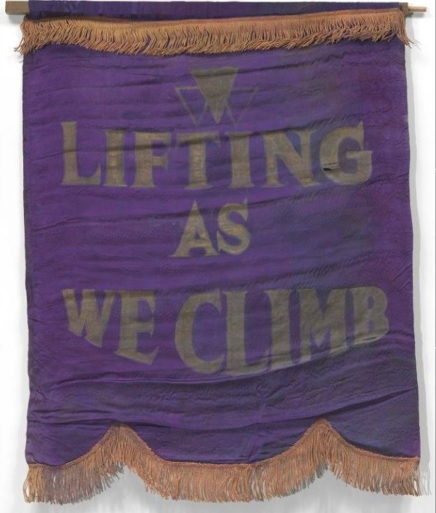
As we commemorate the centennial anniversary of women being granted the right to vote, we need to remember that “women” did not mean “all women.” To honor our suffragist sisters, we continue to fight for equality at the ballot box. Each day this month we will share facts meant to inspire action.
In Sisterhood and Solidarity, NYSUT Women
Voting Rights Awareness Day 14
In Boston, in 1896, Black reformers like Josephine St. Pierre Ruffin and Charlotte Forten Grimke founded the National Association of Colored Women (NACW). Members discussed ways of attaining civil rights and women’s suffrage.
Their motto, “Lifting as we climb,” reflected the organization’s goal to “uplift” the status of Black women.
#NYSUTWomenVote2020
Learn more here: https://www.nps.gov/articles/black-women-and-the-fight-for-voting-rights.htm
Notes:
Similar to slide about Mary Terrell....merge and recreate for Grimke or Ruffin biography?

Slide 16
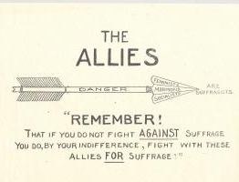
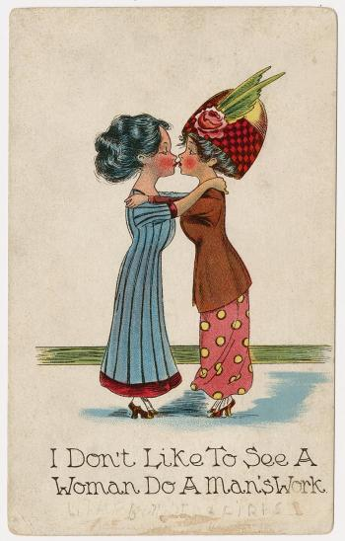
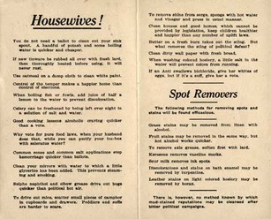
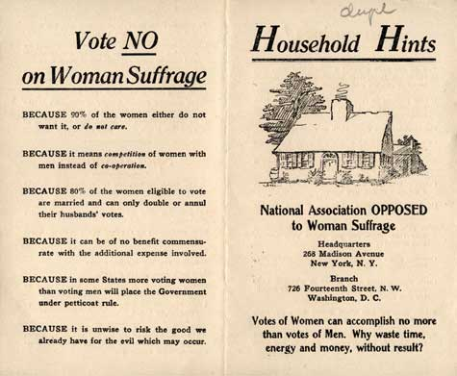
As we commemorate the centennial anniversary of women being granted the right to vote, we need to remember that “women” did not mean “all women.” To honor our suffragist sisters, we continue to fight for equality at the ballot box. Each day this month we will share facts meant to inspire action.
Voting Rights Awareness Day 15
In Sisterhood and Solidarity, NYSUT Women
Anti-suffragists found gender role reversal to be most upsetting, and many postcards and images depict men tending babies or doing housework. While today we find these images very funny, and certainly people of the time would have laughed at them, the underlying message—that proper gender roles stabilized the nation-state—would have resonated with people who feared the dramatic changes expected by the granting of suffrage to women.
Anti-suffrage political cartoon containing text, "Remember! That if you do not fight against suffrage you do, by your indifference, fight with these allies for suffrage!" "Allies" are listed as Feminists, Mormons, and Socialists.
National Association OPPOSED to Woman Suffrage published a pamphlet explaining why women shouldn't be allowed to vote. The pamphlet also included list of household cleaning tips for women. The pamphlet includes a list of household cleaning tips for women.
"You do not need a ballot to
clean out your sink spout."
Anti-suffrage postcard depicting two women kissing with caption.
“I don't like to see a woman do a man's work.”
#NYSUTWomenVote2020
Learn more here: https://nyheritage.org/exhibits/recognizing-womens-right-vote/women%E2%80%99s-march-january-2017
https://www.theatlantic.com/sexes/archive/2012/11/vote-no-on-womens-suffrage-bizarre-reasons-for-not-letting-women-v
ote/264639/
Notes:
Do we have a website for this?

Slide 17
As we commemorate the centennial anniversary of women being granted the right to vote, we need to remember that “women” did not mean “all women.” To honor our suffragist sisters, we continue to fight for equality at the ballot box. Each day this month we will share facts meant to inspire action.
In Sisterhood and Solidarity, NYSUT Women
Voting Rights Awareness Day 16
Dr. Mabel Ping-Hua Lee
Suffragist who mobilized the Chinese community in America
to support women’s right to vote
Chinese women, like Mabel Lee, could not vote until 1943. This was because of the Chinese Exclusion Act, a Federal law in place from 1882 to 1943. The Chinese Exclusion Act limited Chinese immigration and prevented Chinese immigrants from becoming citizens. Without US citizenship, Mabel Lee could not vote. Yet, she and other Chinese suffragists advocated for women’s voting rights, even though they did not benefit from the legislation.
#NYSUTWomenVote2020
Learn more here: https://www.nps.gov/people/mabel-lee.htm

Slide 18
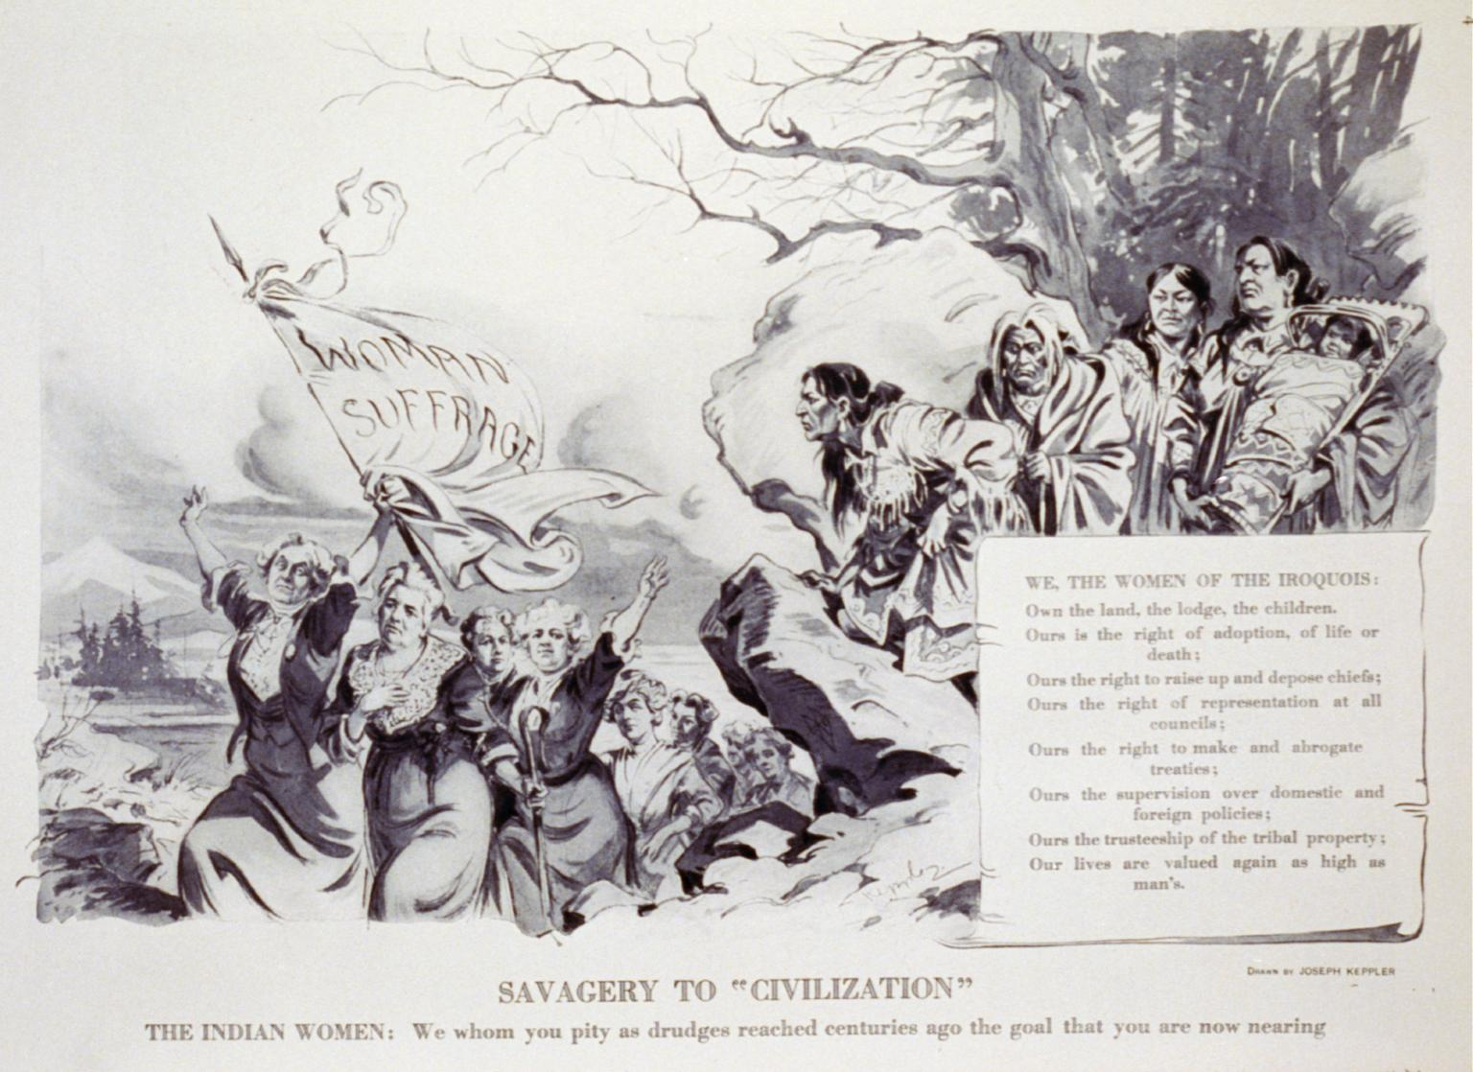
As we commemorate the centennial anniversary of women being granted the right to vote, we need to remember that “women” did not mean “all women.” To honor our suffragist sisters, we continue to fight for equality at the ballot box. Each day this month we will share facts meant to inspire action.
In Sisterhood and Solidarity, NYSUT Women
Voting Rights Awareness Day 17
Savagery to "Civilization,” by Joseph Keppler. This illustration shows Iroquois women on a rock overlooking women marching with banner labeled "Woman Suffrage.”
Text reads: "WE, THE WOMEN OF THE IROQUOIS: Own the land, the lodge, the children. Ours is the right of adoption, of life or death; Ours is right to raise up and depose chiefs; Ours the right of representation at all councils; Ours the right to make and abrogate treaties; Ours the supervision over domestic and foreign policies; Ours the trusteeship of the tribal property; Our lives are valued again as high as man's.
Originally published in Puck, v. 75, no. 1941 (1914 May 16), p.4. Courtesy of the Library of Congress.
THE INDIAN WOMEN: We whom you pity as drudges reached centuries ago the goal that you are now nearing."
#NYSUTWomenVote2020
Learn more here: https://nyheritage.org/exhibits/recognizing-womens-right-vote/haudenosaunee

Slide 19
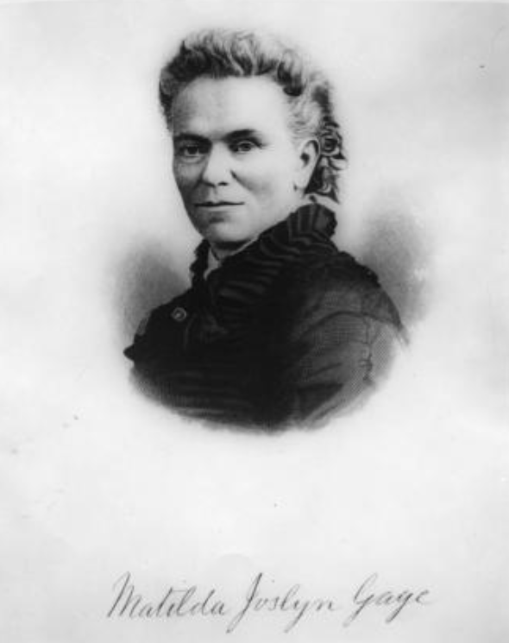
As we commemorate the centennial anniversary of women being granted the right to vote, we need to remember that “women” did not mean “all women.” To honor our suffragist sisters, we continue to fight for equality at the ballot box. Each day this month we will share facts meant to inspire action.
In Sisterhood and Solidarity, NYSUT Women
In Sisterhood and Solidarity, NYSUT Women
Voting Rights Awareness Day 18
Portrait of Matilda Joslyn Gage. Gage, along with Susan B. Anthony, and Lillie Devereux Blake addressed the Judiciary committee of the New York State legislature, requesting a bill exempting all women from the payment of taxes until given the vote.
Elections matter. Vote.
#NYSUTWomenVote2020
Learn more here: https://nyheritage.org/exhibits/recognizing-womens-right-vote/tax-protest

Slide 20
As we commemorate the centennial anniversary of women being granted the right to vote, we need to remember that “women” did not mean “all women.” To honor our suffragist sisters, we continue to fight for equality at the ballot box. Each day this month we will share facts meant to inspire action.
In Sisterhood and Solidarity, NYSUT Women
Voting Rights Awareness Day 19
While an Equal Rights Amendment was introduced in Congress in 1924, no grass-roots movement existed to push it forward. Although the 1960-70 wave of feminism picked up the banner, women citizens of the United States today still do not have equal rights guaranteed in the Constitution, ninety-three years after the introduction of the Equal Rights Amendment.
The Equal Rights Amendment
Three years after the ratification of the 19th amendment, the Equal Rights Amendment (ERA) was initially proposed in Congress in an effort to secure full equality for women. It seeked to end the legal distinctions between men and women in terms of divorce, property, employment, and other matters. It failed to achieve ratification, but women gradually achieved greater equality through legal victories that continued the effort to expand rights, including the Voting Rights Act of 1965, which ultimately codified the right to vote for all women.
To date, thirty-seven states have passed ERA bills.
#NYSUTWomenVote2020
Learn more here: Women's March, January 2017 https://www.archives.gov/women/era

Slide 21
As we commemorate the centennial anniversary of women being granted the right to vote, we need to remember that “women” did not mean “all women.” To honor our suffragist sisters, we continue to fight for equality at the ballot box. Each day this month we will share facts meant to inspire action.
In Sisterhood and Solidarity, NYSUT Women
Voting Rights Awareness Day 20
“If women want any rights more than they's got, why don't they just take them, and not be talking about it.”
~ Sojourner Truth
Sojourner Truth: Advocate for the rights of women and African Americans; abolitionist; author; speaker
Born into slavery in New York State, Truth became one of the strongest voices for equality and justice in the abolitionist and women’s suffrage movement.
In May 1851, she attended the Ohio Women’s Rights Convention in Akron, where she delivered one of the most famous speeches on African American and women’s rights in American history, “Ain’t I a Woman?”
For most of her remaining life, Truth continued to travel the United States to speak on matters relating to the rights of African Americans and women, including the right to vote.
#NYSUTWomenVote2020
Learn more here:https://www.nps.gov/people/sojourner-truth.htm
Notes:
Done, but I think there are too many words.

Slide 22
As we commemorate the centennial anniversary of women being granted the right to vote, we need to remember that “women” did not mean “all women.” To honor our suffragist sisters, we continue to fight for equality at the ballot box. Each day this month we will share facts meant to inspire action.
In Sisterhood and Solidarity, NYSUT Women
Voting Rights Awareness Day 21
“The way to right wrongs is to turn the light of truth upon them.”
In 1909, Ida B. Wells was a founding member of the NAACP. She was a teacher who lost her job for protesting racial inequality in schools. After the lynching of three of her friends, she became a co-owner of the Memphis Free Speech and printed an article about their murder. She was chased out of town as a result.
100 years ago, five thousand women marched on Washington, DC to demand the right to vote. Ida B. Wells was told to march at the back of the line with the black suffragists. She refused.
#NYSUTWomenVote2020
Learn more here: https://www.pbs.org/blackpress/news_bios/wells.html

Slide 23
As we commemorate the centennial anniversary of women being granted the right to vote, we need to remember that “women” did not mean “all women.” To honor our suffragist sisters, we continue to fight for equality at the ballot box. Each day this month we will share facts meant to inspire action.
In Sisterhood and Solidarity, NYSUT Women
In Sisterhood and Solidarity, NYSUT Women
Voting Rights Awareness Day 22
When women in New York State won the right to vote in 1917, they changed the national political landscape. New York was not the first state to give women the vote, but it was a tipping point for the suffrage movement. In August 1920, the 19th Amendment granted women the right to vote. It is also important to note that while legally entitled to vote, black women were effectively denied voting rights in numerous Southern states until 1965.
Movements to end inequality have no beginning and no end, but rather ebb and flow in waves. The strategic decision to focus solely on gaining the vote and drop the issues like wage equity, legal reform, and body rights for which nineteenth century women had been working had consequences.
The League of Women Voters emerged out of the National American Woman Suffrage Association, powerfully determined to get women to vote in an educated way, but the organized momentum to push for specific reforms for women had been lost.
Elections matter. Vote.
#NYSUTWomenVote2020
Learn more here: https://nyheritage.org/exhibits/recognizing-womens-right-vote/women%E2%80%99s-march-january-2017

Slide 24
As we commemorate the centennial anniversary of women being granted the right to vote, we need to remember that “women” did not mean “all women.” To honor our suffragist sisters, we continue to fight for equality at the ballot box. Each day this month we will share facts meant to inspire action.
In Sisterhood and Solidarity, NYSUT Women
Voting Rights Awareness Day 23
In response to the brutality faced by peaceful voting rights protesters, civil rights leaders organized a 54 mile march from Selma to Montgomery, Alabama. Gov. Wallace ordered state troopers “to use whatever measures are necessary to prevent a march.” Troopers used tear gas, clubs, whips, and rubber tubing wrapped in barbed wire. The protestors did not fight back, and the news media were there to document what became known as, “Bloody Sunday.” This atrocity galvanized public opinion around voting rights. Five months later, the Voting Rights Act was passed.
#NYSUTWomenVote2020
Learn more here: https://www.history.com/news/selma-bloody-sunday-attack-civil-rights-movement

Slide 25
.,
As we commemorate the centennial anniversary of women being granted the right to vote, we need to remember that “women” did not mean “all women.” To honor our suffragist sisters, we continue to fight for equality at the ballot box. Each day this month we will share facts meant to inspire action.
In Sisterhood and Solidarity, NYSUT Women
Voting Rights Awareness Day 24
In July 2020, The League of Women Voters sued the NYS Board of Elections
citing flawed absentee ballot procedures that resulted in rejected ballots.
Use the following sites to fill out your absentee ballot correctly.
https://www.elections.ny.gov/votingabsentee.html
https://www.vote.org/absentee-ballot/new-york/
Make sure your voice is heard!
#NYSUTWomenVote2020

Slide 26
As we commemorate the centennial anniversary of women being granted the right to vote, we need to remember that “women” did not mean “all women.” To honor our suffragist sisters, we continue to fight for equality at the ballot box. Each day this month we will share facts meant to inspire action. In Sisterhood and Solidarity, NYSUT Women
Voting Rights Awareness Day 25
The 19th Amendment passed by only one vote.
The suffragists would need one more vote to make the 19th Amendment the law of the land, and what happened stunned the legislature. Early in the voting, Harry T. Burn, who came from a conservative district and wore the red rose on his lapel, surprised everyone when he said in a clear voice, “aye,” when asked if he would vote to ratify the amendment.
Burn also had a letter in his suit pocket, from his mother, Febb E. Burn, in which she asked him to, “be a good boy,” and vote for the amendment. When Banks Turner also voted in favor of the ratification, the 70-year-old battle for suffrage was over.
“I knew that a mother’s advice is always safest for a boy to follow and my mother wanted me to vote for ratification,” he said. “I appreciated the fact that an opportunity such as seldom comes to a mortal man to free 17 million women from political slavery was mine.”
Febb E. Burn then said she was pressured in person by the governor of Louisiana’s wife to recant the letter and say it was a fraud. She refused to do so.
#NYSUTWomenVote2020
Learn more here: https://constitutioncenter.org/blog/the-man-and-his-mom-who-gave-women-the-vote/
Notes:
Done.

Slide 27
As we commemorate the centennial anniversary of women being granted the right to vote, we need to remember that “women” did not mean “all women.” To honor our suffragist sisters, we continue to fight for equality at the ballot box. Each day this month we will share facts meant to inspire action.
In Sisterhood and Solidarity, NYSUT Women
Voting Rights Awareness Day 26
Victoria Woodhull, one of the most colorful and vivid figures of the U.S. women’s suffrage movement, rose from poor and eccentric origins. As children, she and her sister Tennessee Claflin gave psychic readings and healing sessions in a traveling family show. In 1870, with backing from railroad tycoon Cornelius Vanderbilt, the sisters opened a stock brokerage firm. They used their Wall Street profits to bankroll a controversial newspaper, which supported such causes as legalized prostitution and free love.
Victoria won increased respect from women’s rights activists when she argued on behalf of female suffrage in front of the House Judiciary Committee in early 1871, and the following year the Equal Rights Party nominated her for president of the United States. By the time of the general election in 1872, Woodhull’s enemies had gotten the better of her temporarily, and she spent Election Day in jail after publishing an article that accused the popular preacher Henry Ward Beecher of adultery.
Victoria Woodhull ran for political office nearly 50 years before women got the vote.
#NYSUTWomenVote2020
Learn more here: 7 Things You Might Not Know About the Women’s Suffrage Movement
Notes:
Done. LMAO
#NYSUTapproved

Slide 28
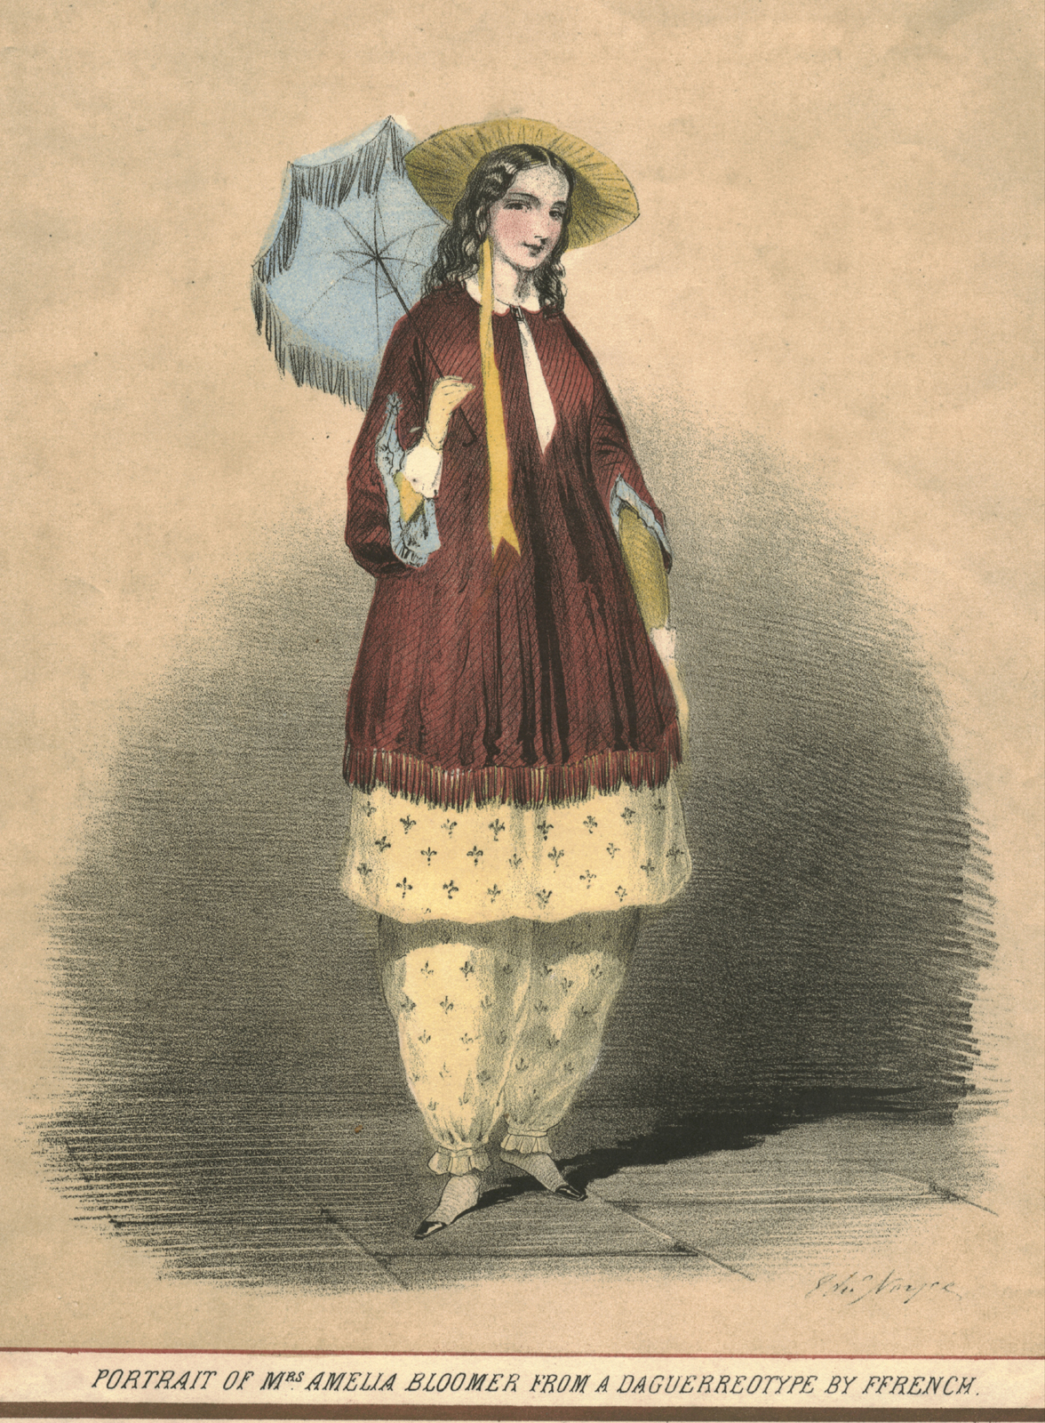
As we commemorate the centennial anniversary of women being granted the right to vote, we need to remember that “women” did not mean “all women.” To honor our suffragist sisters, we continue to fight for equality at the ballot box. Each day this month we will share facts meant to inspire action.
In Sisterhood and Solidarity, NYSUT Women
Voting Rights Awareness Day 27
When “bloomers,” as they became known, were being worn by more and more suffragists, Elizabeth Cady Stanton stated, "The question is no longer how do you look, but woman, how do you feel?"
Elizabeth Smith Miller, while working in the garden in 1851, decided that her clothing should no longer be a hindrance to her activity. Turkish trousers to the ankle with a skirt reaching some four inches below the knee, were substituted for the heavy, untidy and exasperating old garment.
Miller argued that women needed to escape ‘the kingdom of fancy and fashion and foolery.’ When they were worn at Seneca Falls, none embraced them with more enthusiasm than Amelia Bloomer. She advocated their use in the Lily, her temperance and women’s rights paper, stating that women ‘have been and are slaves, while man in dress and all things else is free’.
When you find a burden in belief or apparel, cast it off.
-Amelia Bloomer
#NYSUTWomenVote2020
Learn more here: https://helenrappaport.com/footnotes/rational-dress/
Notes:
When “bloomers,” as they became known, were being worn by more and more suffragists, Elizabeth Cady Stanton stated, "The question is no longer how do you look, but woman, how do you feel?"
Bloomers freed women from disfiguring corsets and crinolines. But while health concerns were a socially acceptable reason for reforming fashion, for many, political ideology was not.

Slide 29
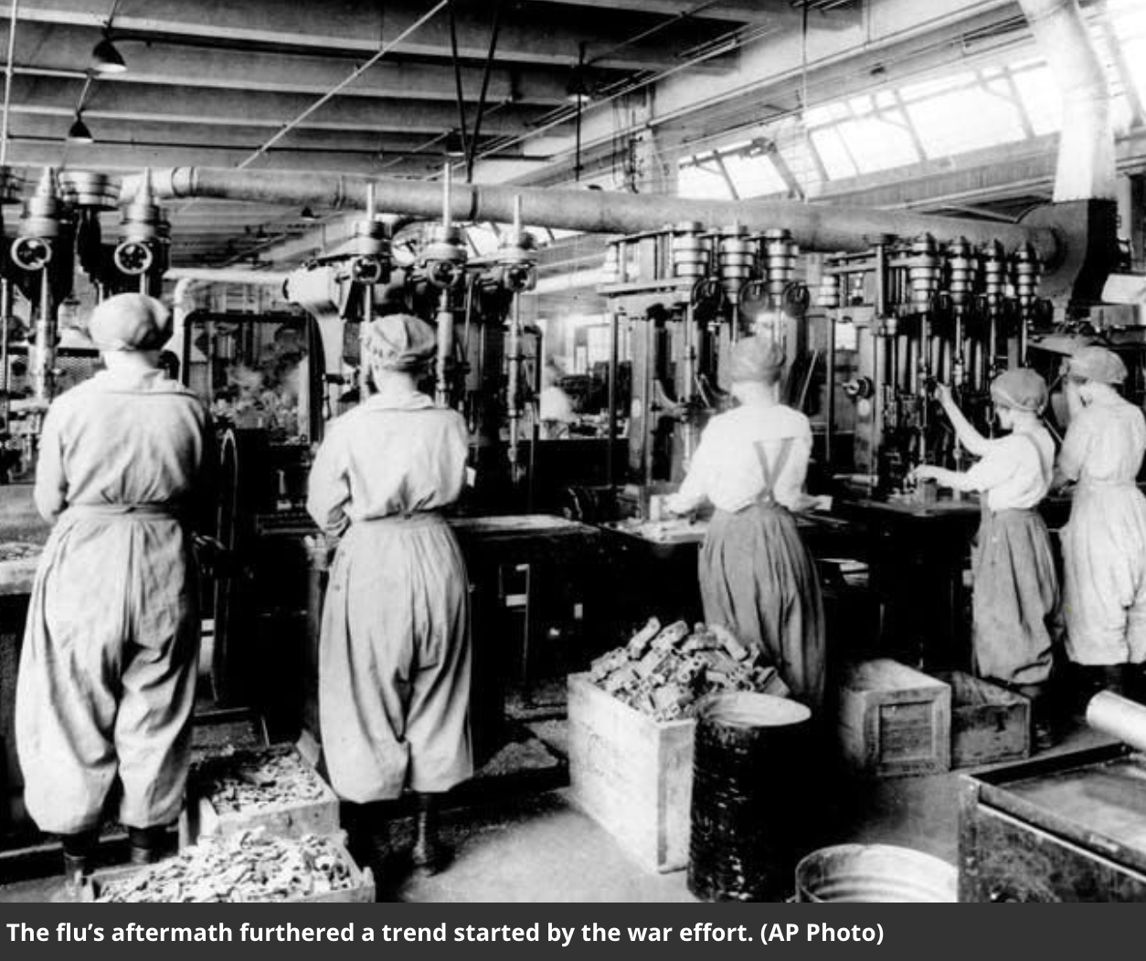
As we commemorate the centennial anniversary of women being granted the right to vote, we need to remember that “women” did not mean “all women.” To honor our suffragist sisters, we continue to fight for equality at the ballot box. Each day this month we will share facts meant to inspire action.
In Sisterhood and Solidarity, NYSUT Women
Voting Rights Awareness Day 28
Once a woman’s the boss,
how can you deny her the vote?
A tragic pandemic helped the cause:
The 1918 flu spread easily among soldiers in the last stages of World War I, creating a sudden shortage of men. As women surged into the U.S. workforce, they blew apart the arguments that they were delicate and intellectually inferior — and unequal pay and poor working conditions galvanized their drive for equal rights and protections.
Increased participation in the workforce allowed many women to obtain social and financial independence. Leadership positions within the workforce could now be occupied by women, especially in the garment industry, but also in the military and police forces. The U.S. even got its first woman governor, when Nellie Taylor Ross took her oath of office, in 1923, in Wyoming.
#NYSUTWomenVote2020
Learn more here: Things you didn’t know (or maybe forgot) about how women got the vote
Notes:
Done.

Slide 30
As we commemorate the centennial anniversary of women being granted the right to vote, we need to remember that “women” did not mean “all women.” To honor our suffragist sisters, we continue to fight for equality at the ballot box. Each day this month we will share facts meant to inspire action. In Sisterhood and Solidarity, NYSUT Women
Voting Rights Awareness Day 29
Cover of The Woman Suffrage Cook Book, published in 1886. Hattie Burr, the editor, noted proudly that "among the contributors are many who are eminent in their professions as teachers, lecturers, physicians, ministers, and authors — whose names are household words in the land."
Dedication:
To the first woman who realized that half of the human race were not getting a square deal, and who had the courage to voice a protest; and also to the long line of women from that day unto this, who saw clearly, thought strongly, and braved misrepresentation, ridicule, calumny, and social ostracism, to bring about that millennial Day when humanity shall know the blessedness of dwelling together as equals.
To all those valiant and undaunted soldiers of progress we dedicate our labors in compiling this volume.
The 1909 Washington Women's Cook Book, opened with the couplet:
Give us the vote and we will cook
The Better for a wide outlook
Sold at fairs, bazaars, and women's exchanges, cookbooks raised funds for the suffrage movement and helped women network with each other. These cookbooks countered the argument that suffragists were neglectful mothers and bad wives, neglecting their households in order to be politically active. Recipes were contributed by regular housewives who carried a "Mrs." before their name, as well as a parade of prominent suffragists who didn't.
#NYSUTWomenVote2020
Learn more here: How Suffragists Used Cookbooks As A Recipe For Subversion

Slide 31
As we commemorate the centennial anniversary of women being granted the right to vote, we need to remember that “women” did not mean “all women.” To honor our suffragist sisters, we continue to fight for equality at the ballot box. Each day this month we will share facts meant to inspire action.
In Sisterhood and Solidarity, NYSUT Women
Voting Rights Awareness Day 30
At a meeting in Madison Square Garden, Barnum & Bailey Circus performer Josephine DeMott Robinson stood to speak on suffrage:
“You earn salaries,” she said. “Some of you have property. You have a right to say what shall be done with it. You want to establish clearly in the mind of your husband that you are his equal. You are not above him, but his equal. You are not slaves.”
In a society that did all it could to marginalize strong women, circus women were stars who traveled the country and earned their own living. They are lesser-known heroes in the fight for suffrage.
Josephine DeMott Robinson
1917
#NYSUTWomenVote2020
Learn more here:
Barnum & Bailey's Forgotten High-Flying Suffragists
Notes:
Done.

Slide 32
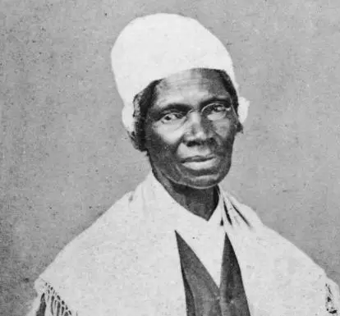
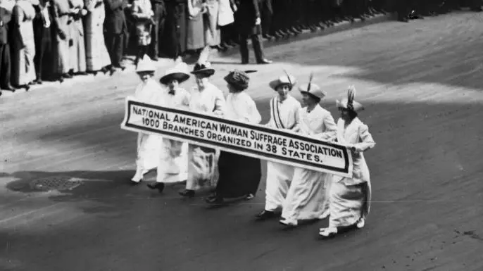
As we commemorate the centennial anniversary of women being granted the right to vote, we need to remember that “women” did not mean “all women.” To honor our suffragist sisters, we continue to fight for equality at the ballot box. Each day this month we will share facts meant to inspire action.
In Sisterhood and Solidarity, NYSUT Women
Voting Rights Awareness Day 31
The US women’s suffrage movement had its roots in the abolition movement.
Abolitionist groups such as the American Anti-Slavery Society (AASS), provided women with opportunities to speak, write and organize on behalf of enslaved people—and in some cases gave them leadership roles. Sojourner Truth, whose “Ain’t I a Woman?” speech in 1851 earned her lasting fame.
After the Civil War, many abolitionists and women’s rights activists parted ways over women's suffrage.
In the early years of the women’s rights movement, the agenda included much more than just the right to vote. Their broad goals included equal access to education and employment, equality within marriage, and a married woman’s right to her own property and wages, custody over her children and control over her own body.
After the Civil War, debate over the 14th and 15th Amendments to the Constitution— which would grant citizenship and suffrage to African-American men—inspired many women’s rights activists to refocus their efforts on the battle for female suffrage.
#NYSUTWomenVote2020
Learn more here:
https://www.history.com/news/7-things-you-might-not-know-about-the-womens-suffrage-movement?fbclid=IwAR0azOHsNulEMuMn_Z1LaCZRJzp6AkJYCsErHov7G4AR0lyQN27I-77O0v0
Notes:
Done.

Slide 33
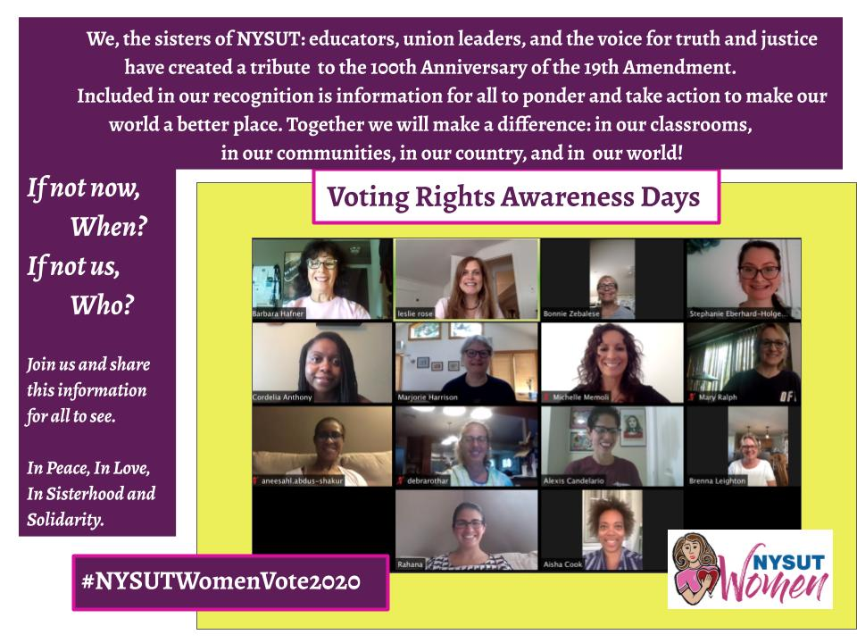
✽ the creators

