Slide 1


Slide 2
Can be used to review for the ILST
Review of vocabulary and concepts
Introduces some concepts that will be expanded on in LE and ES
Appropriate level text with text dependent questions

Slide 3
Lexile Score
The Lexile Framework for Reading
www.Lexile.com
This is a measure of the readability of the text.
Text can be measured using the website.

Slide 4
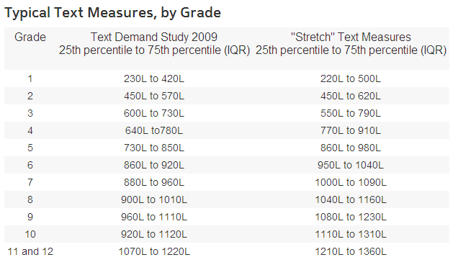
The “Stretch” Text Measures are the ones developed by NYS to increase rigor and are the appropriate ones to use

Slide 5
Lexile Score
Whose Air is it Anyway?
1130 Lexile
the 8th grade range is: 1040L – 1160L

Slide 6
How do we teach CC ?
Teacher reads article to students
Students should read the passage at least one additional time
Go paragraph by paragraph
Check for comprehension
  Vocabulary - Teach context clues
  Concepts
Write summaries
Notes:
Paragraph 7 – omit part of sentence

Slide 7

Slide 1 - introduction

Slide 8
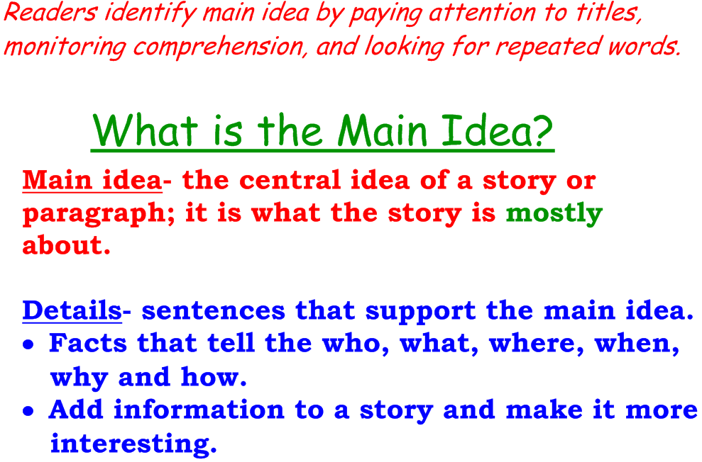
Slide 2 – Prereading
Use this slide to introduce the concept of Main Idea prior to students reading the article
Return to slide 1 and ask students what they think the article is about (class discussion)

Slide 9
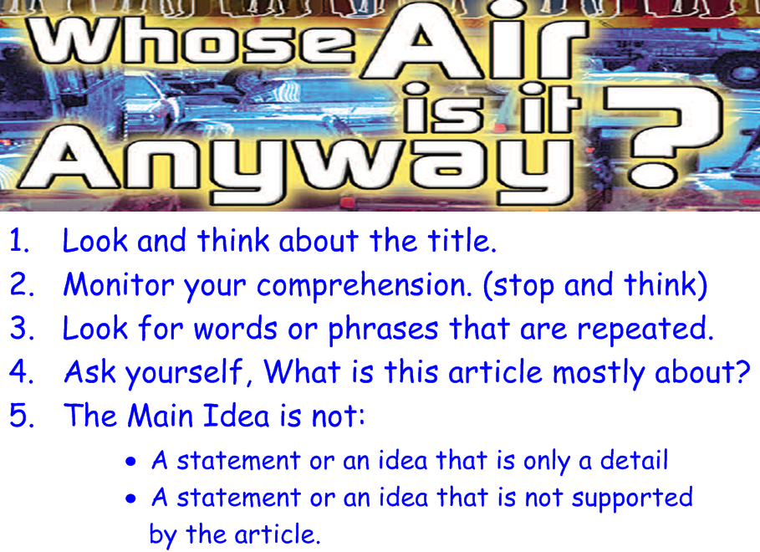
Slide 3 – Prereading
After students have predicted what the article is about use this slide to further develop the concept of the main idea and introduce slide 4

Slide 10
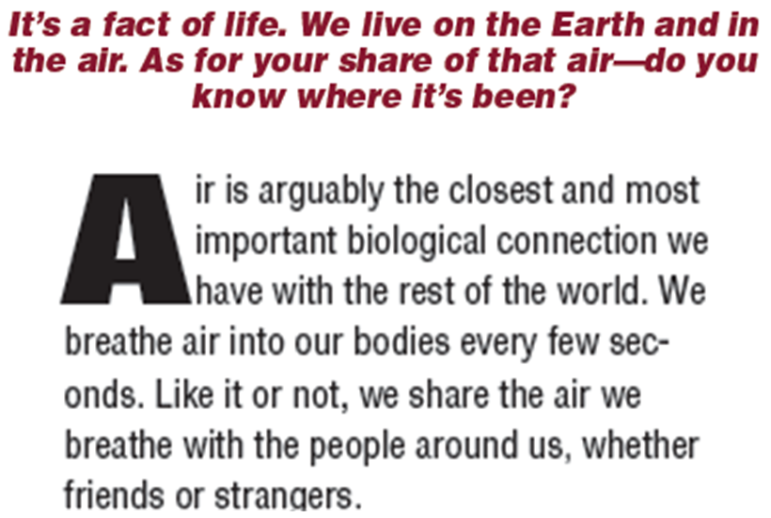
Slide 4 - Prereading
This is the introductory paragraph of the article
Read, or have students read, the paragraph and then discuss what they think the article is about with this
additional
information

Slide 11
Prereading
Give students copies of the article to read
  This can be assigned as homework or done as silent reading
The first reading of the article can be done (modeled) by the teacher for ELL or Special Education students followed by the students rereading the article independently
This can be given to the students as a written assignment or done as a class discussion after they have read the article
  This slide can
  be used for
  follow-up
  (class discussion)

Slide 12
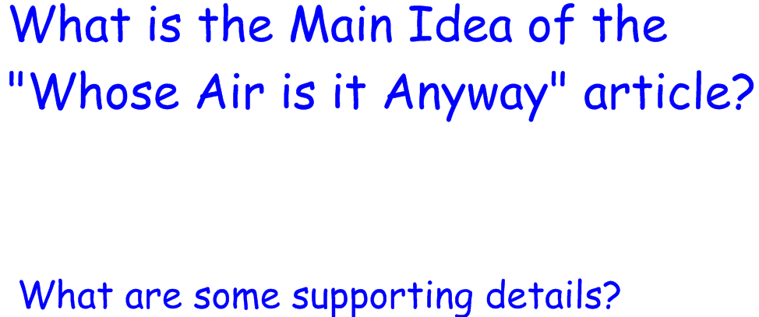
Slide 5 - Prereading
Use this slide to introduce the students to developing their own understanding of the Main Idea and the use of supporting evidence
This can be assigned as a written assignment or given as something for the students to think about as they read

Slide 13
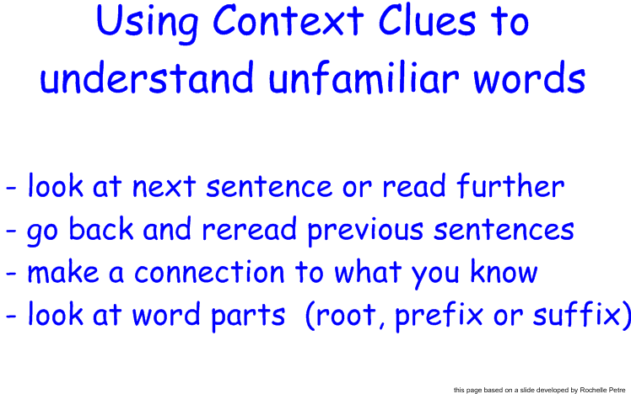
Slide 6 – Group reading
Using Context Clues
This slide is used to introduce the Vocabulary Sheet (slide 7)
The students should fill out the sheet for unfamiliar words and what they think the meaning is from the context clues during their independent read

Slide 14
Slide 6 – Group reading
Using Context Clues
Depending on student levels/needs (SWD, ELL) this sheet can be discussed and assigned to be used during the reread or an example can be done with the class first before assigning the independent read

Slide 15
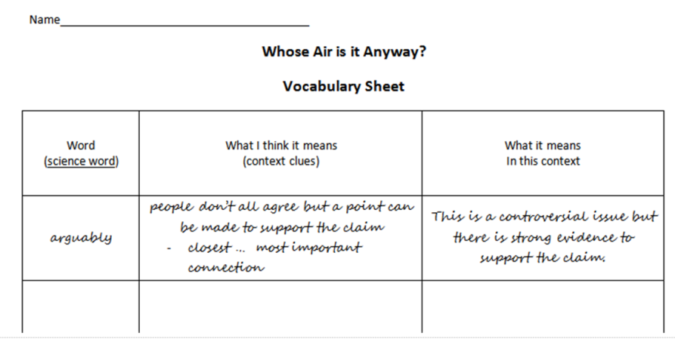
Slide 7 – Group reading
Using Context Clues
Students should fill out the vocabulary sheet for any unfamiliar words while reading the article
During the reread students should discuss each word that they included on their sheet as each paragraph is read and fill in the corrected definitions

Slide 16

Day 2 - Group reading
Have students come to a consensus on the main idea of the article (class discussion)
Have individual students share their supporting ideas (class discussion)

Slide 17
Day 2 - Group reading
Reread, or have students reread, the article a paragraph (or short section) at a time
Depending on the level of your students (ELL, SWD, gifted) it may be distracting to stop too often

Slide 18
Day 2 - Group reading
The Excel spreadsheet is a teacher resources to be used as the article is reread. It is broken down by page and paragraph and includes:
Vocabulary
  Science – testable vocabulary on the ILST is in bold face
  Non- science
  Conversational – phrases not literally interpreted

Slide 19
Day 2 - Group reading
Locations – Social Studies link
Science topics
Concepts and text dependent questions by paragraph

Slide 20
Day 2 - Group reading
The following slides explain the Smartboard lesson designed to be used during the reread
The intent is to make the lesson interactive for students and to enhance class discussion of both science topics and vocabulary

Slide 21
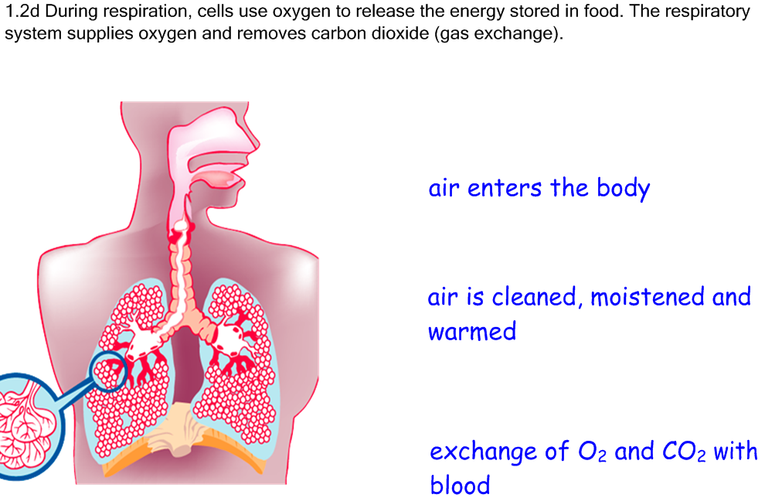
Slide 8 – Group reading
Paragraph 2
After reading the paragraph have a brief review of breathing and respiration
With this slide concentrate on breathing
Have students draw
arrows from the
descriptions to the to
the appropriate
location on the model

Slide 22
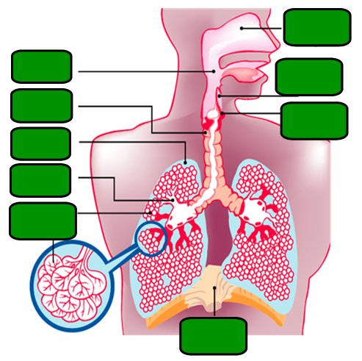
Slide 9 – Group reading
Paragraph 2-3
Respiratory System review – interactive class discussion
Students can move the green boxes to reveal the labels for each organ after they have identified it

Slide 23
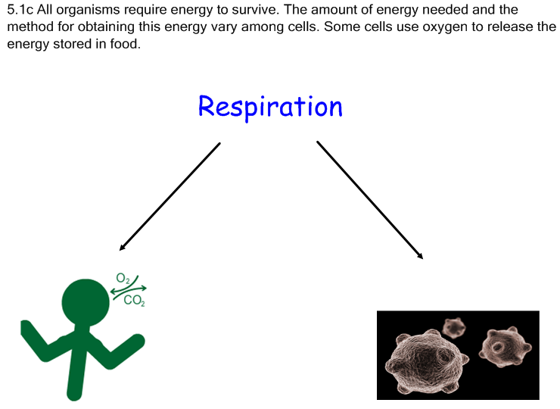
Slide 10 – Group reading
Paragraph 3
Respiration Review – Major Understanding 5.1c of the Intermediate Core Curriculum
Use the slide to initiate a class discussion comparing aerobic and anaerobic respiration

Slide 24
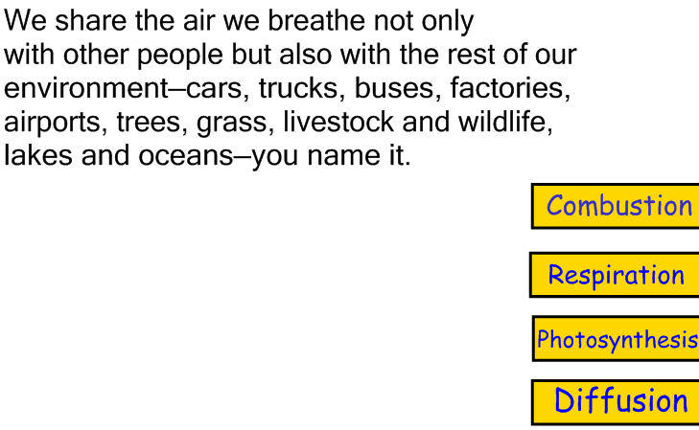
Slide 11 – Group reading
Paragraph 3
Vocabulary Review – interactive slide to initiate class discussion about what the relationship is between the paragraph and the words on the left
Students can pull the words to the left to reveal the definitions

Slide 25
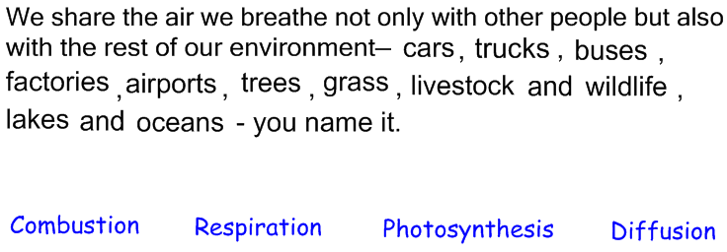
Slide 12 – Group reading
Paragraph3
This interactive slide allows students to pull each word from the paragraph into the column that they think it belongs
Class discussion will probably develop over some of the choices

Slide 26
Slide 12 – Group reading
Paragraph 3
Students will most likely group the grass and trees under the Photosynthesis column
After students have said they are happy with their results I move the grass and trees to the respiration column initiating a discussion about plant respiration
We decide to put them in the middle between the 2 columns

Slide 27
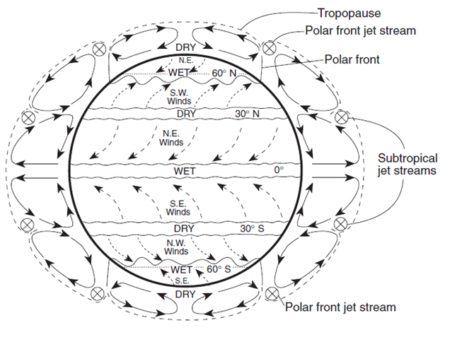
Slide 13 – Group reading
Paragraph 4
This slide is from the Earth Science Reference tables
Initiates a class discussion on global wind patterns

Slide 28
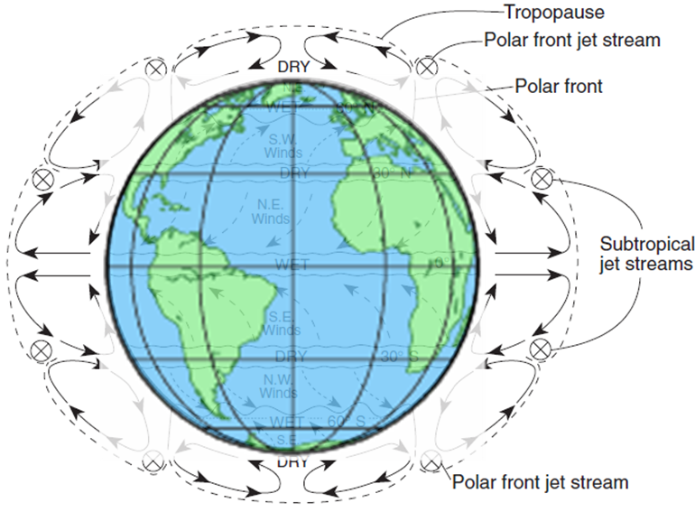
Slide 14 – Group reading
Paragraph 4
Students fill in the student sheet and correlate areas on a globe

Slide 29
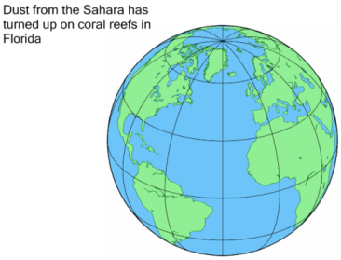
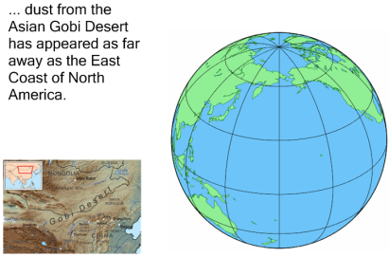
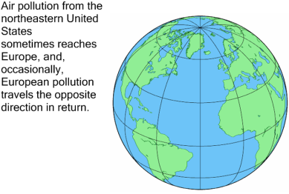
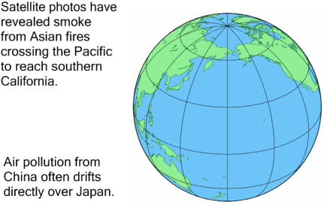
Slides 15 – 18 Group reading
Interactive:
  Students fill in the equator 30^{o,} 60º and 90º latitudes
  Students draw in the prevailing winds between the latitude lines prior to locating the points on each slide

Slide 30
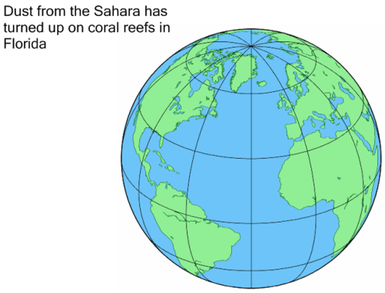
Slide 15 – Group reading
Paragraph 5
Students locate and label Florida and the Sahara desert
Class discussion on the direction of the prevailing winds and movement of dust

Slide 31

Slide 16 – Group reading
Paragraph 5
Students locate the Gobi Desert (map segment added to aid in location) and the East Coast of NA
Class discussion regarding
wind patterns

Slide 32

Slide 17 – Group reading
Paragraph 5
After locating the US and Europe and discussing wind patterns introduce the concept of the shift in global wind patterns with the seasons and the possible reversal of prevailing winds at a location

Slide 33

Slide 18 – Group reading
Paragraph 6
Locate Asia, China, Japan and southern California
Class discussion of wind patterns

Slide 34
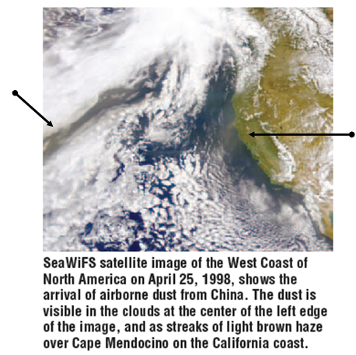
Slide 19 – Group reading
Page 7
Color slide of picture at top of page 7 with arrows pointing to
  dust in clouds
  Haze over Cape Mendocino

Slide 35
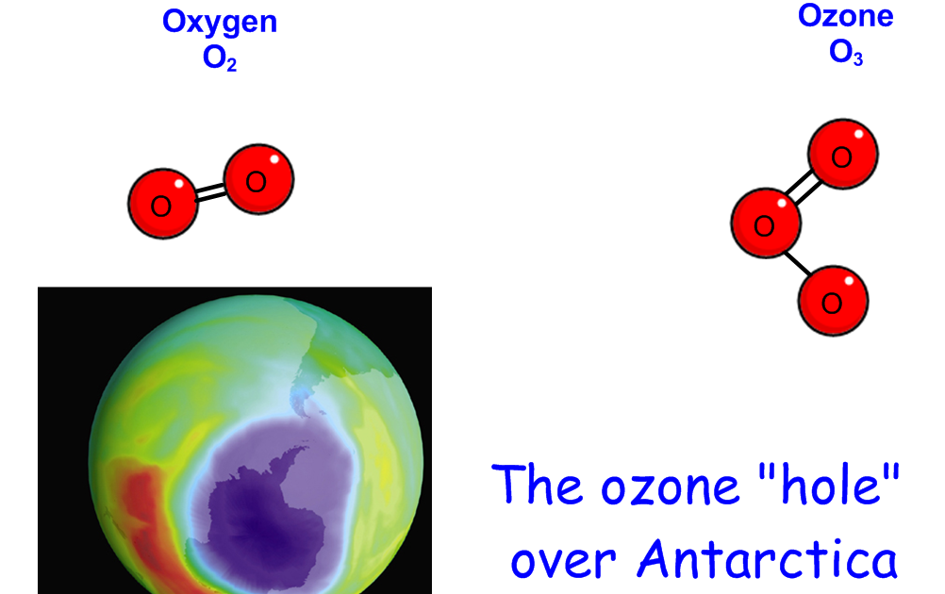
Slide 20 – Group reading
Paragraph 8-11
Use this slide to discuss the structure of ozone
Discuss how there is not a true hole in the
Discus ozone layer but that concentrations are lower there

Slide 36

Slide 20 – Group reading
Paragraph 8
Discuss ozone as an oxidizer
The explanation of ozone as an oxygen donator to willing compounds may be alright at this level, and explanation of oxidation in terms of electrons my be appropriate for better students

Slide 37
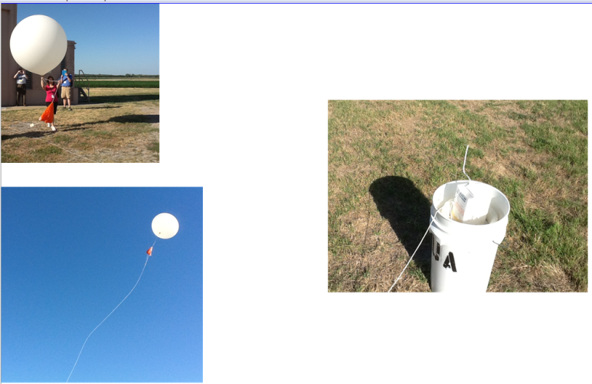
Slide 21 – Group reading
Page 7 - radiosonde/ozonesonde picture
These are pictures of a radiosonde release in Topeka Kansas
Upper left – balloon is filled with Hydrogen, red parachute is visible
Right – instrument box in plastic bucket to insulate from static electricity
Lower left – released balloon

Slide 38
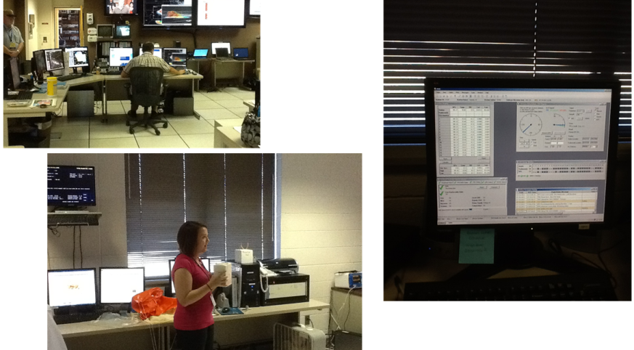
Slide 21 – Group reading
Page 7 - radiosonde / ozonesonde picture
These are pictures of a radiosonde release in Topeka Kansas
Lower left – radiosonde instrument before release, being linked to computers
Upper left, right – computers acquiring data

Slide 39
Slide 21 – Group reading
Paragraph

Slide 40
Slide 20 – Group reading
Paragraph

Slide 41
Slide 20 – Group reading
Paragraph 14

