Slide 1
It just might be the future you're looking for.
NYSUT.org/TakeALookAtTeaching

Slide 2
Take a Look at Teaching Overview Video Here
https://youtu.be/mq_PHxl7cZY

Slide 3
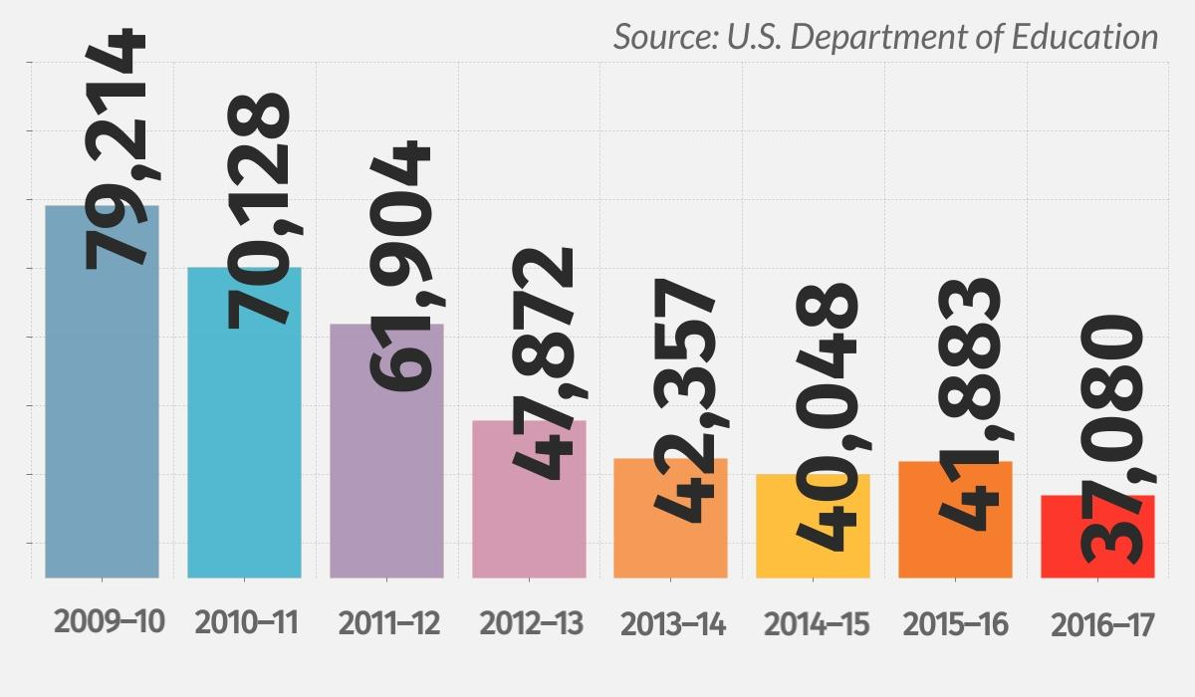
Enrollment in New York’s teacher preparation programs has DECLINED 53% since 2009.

Slide 4
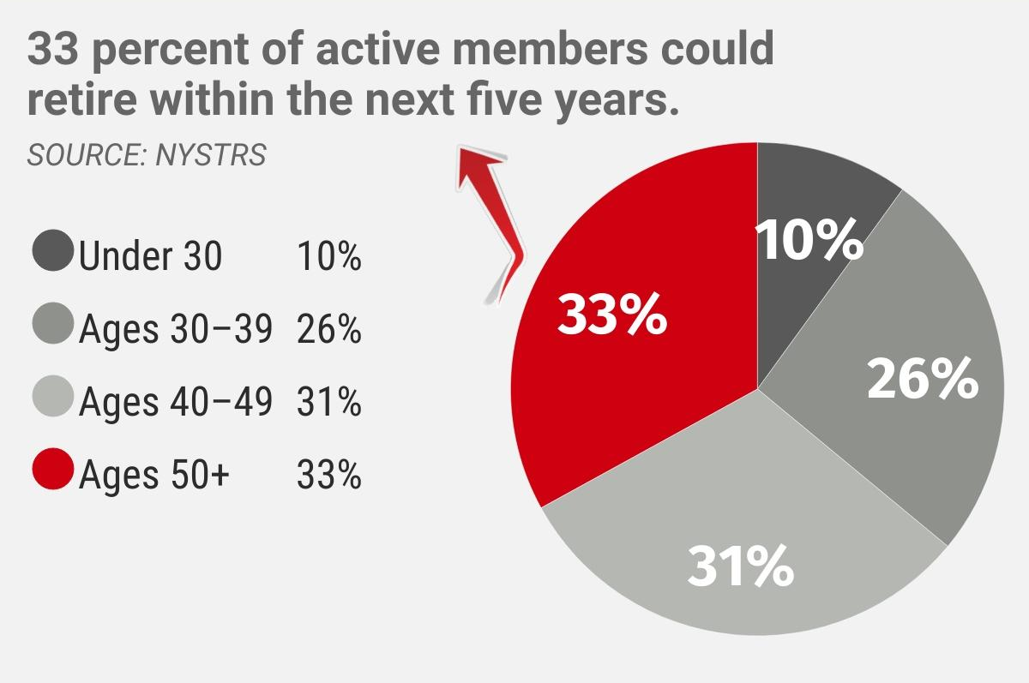
NYS Teachers’ Retirement System projects that
1/3 of New York’s teachers could retire in the next five years.
New York will need 180,000 teachers in the next decade.

Slide 5
The U.S. Department of Education has identified
17 teacher shortage areas throughout New York, up from only two recognized shortage areas a decade ago.
Art and Music Education
Library Media Specialist Staff
Blind/Visually Impaired
Literacy
Career and Technical Education, grades 7-12
Mathematics, grades 7-12
Deaf/Hard of Hearing
Science, grades 7-12
English as a Second Language (ESL)
Social Studies, grades 7-12
ESL with Bilingual Extension
Special Education with Bilingual Extension
English Language Arts, grades 7-12
Students With Disabilities, all grades
Health and Physical Fitness
World Languages
Language and Speech

Slide 6
New York State Workforce Diversity
Hispanic/Latinx or African American Students = 43%
Teacher Workforce = 16%

Slide 7
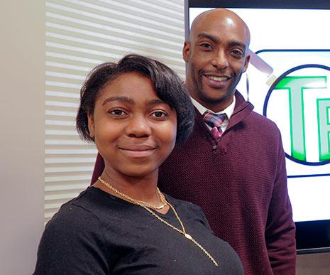
Our Goals
Elevate the teaching profession
Increase the number of students and career changers entering careers in teaching
Improve diversity in the education workforce
Expand P-12/Higher Ed partnerships

Slide 8
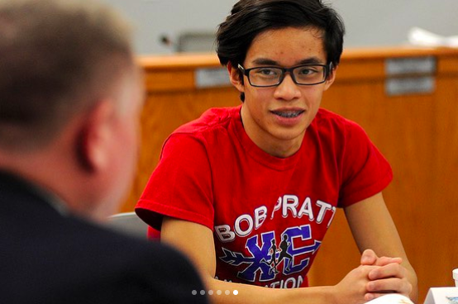
Exploring Solutions
NYSUT.org/TakeALookAtTeaching
Teacher pipeline, grow-your-own programs
Continued dialogue through local Campus Conversations
Legislative Initiatives
Teacher Loan Forgiveness
Mentor Teacher/Intern Program
Teacher Opportunity Corps

Slide 9
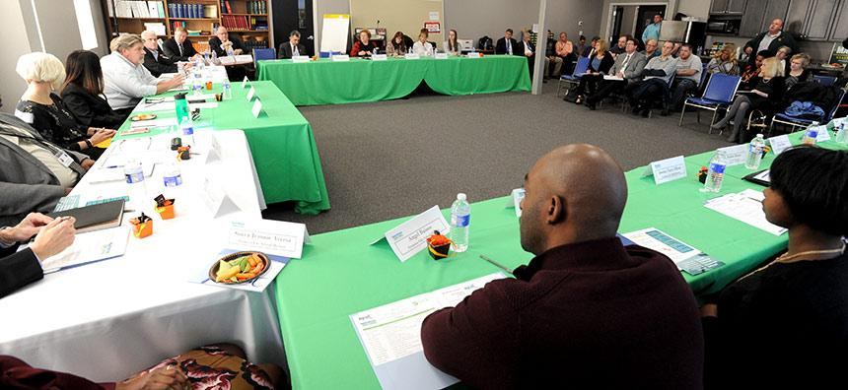
Let’s Get Started
Focus on solutions, not the problems.
Build sustainable relationships to continue these conversations in our communities.
Explore community based solutions. Who are our partners?
Great ideas need action. What are the next steps?

Slide 10
http://bit.ly/takealookatteaching
1. From your experience and in your community, what is the biggest challenge for students and career changers considering a career in education.
2. What could be done in your community to overcome these challenges and support prospective teachers in their path to a career in education?
3. With whom could you partner, locally or throughout the state, to accomplish these goals?
4. What other resources would you need to support your efforts? How might you and your education partners secure these resources?

Slide 11
http://bit.ly/takealookatteaching

Slide 12
It just might be the future you're looking for.
NYSUT.org/TakeALookAtTeaching

