Slide 1
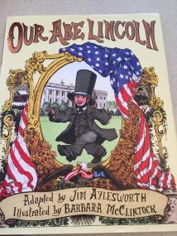
Our Abe Lincoln
Close Reading Character Trait Lesson
Adapted by Jim Aylesworth
Melinda Teter
Kindergarten

Slide 2

Day 1
Read for the fun of it and worked on tier vocabulary (rough, wise, fell). Discussion of new words and facts learned about Abe Lincoln.

Slide 3
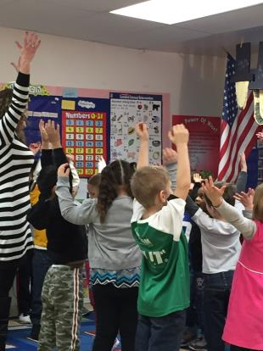
Day 2
Kinesthetic Dramatization
*Warm Up Activity

Slide 4
Kinesthetic Dramatization of
Character Traits
*We used kinesthetic dramatization to assign actions to character trait words that describe Abe Lincoln. (i.e. action of chopping a tree to show
hard-working; action of pointing to our heads to show smart; showed our muscles to show strong)

Slide 5
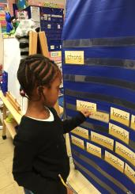
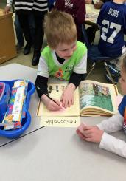
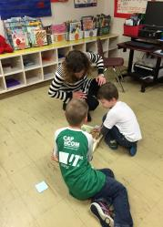
Day 2 continued
Finding Text Evidence
*The children worked in pairs, or groups of 3, and decided which character traits to find evidence of in the text. They began by finding a character trait word in the pocket chart, and then worked together to find the page in the book where that character trait was illustrated.
*The children then copied each chosen character word on sticky notes and stuck it to the appropriate page that illustrated that character trait. They did this for 4 words.

Slide 6
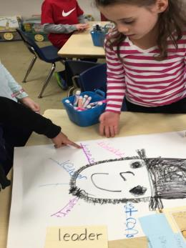
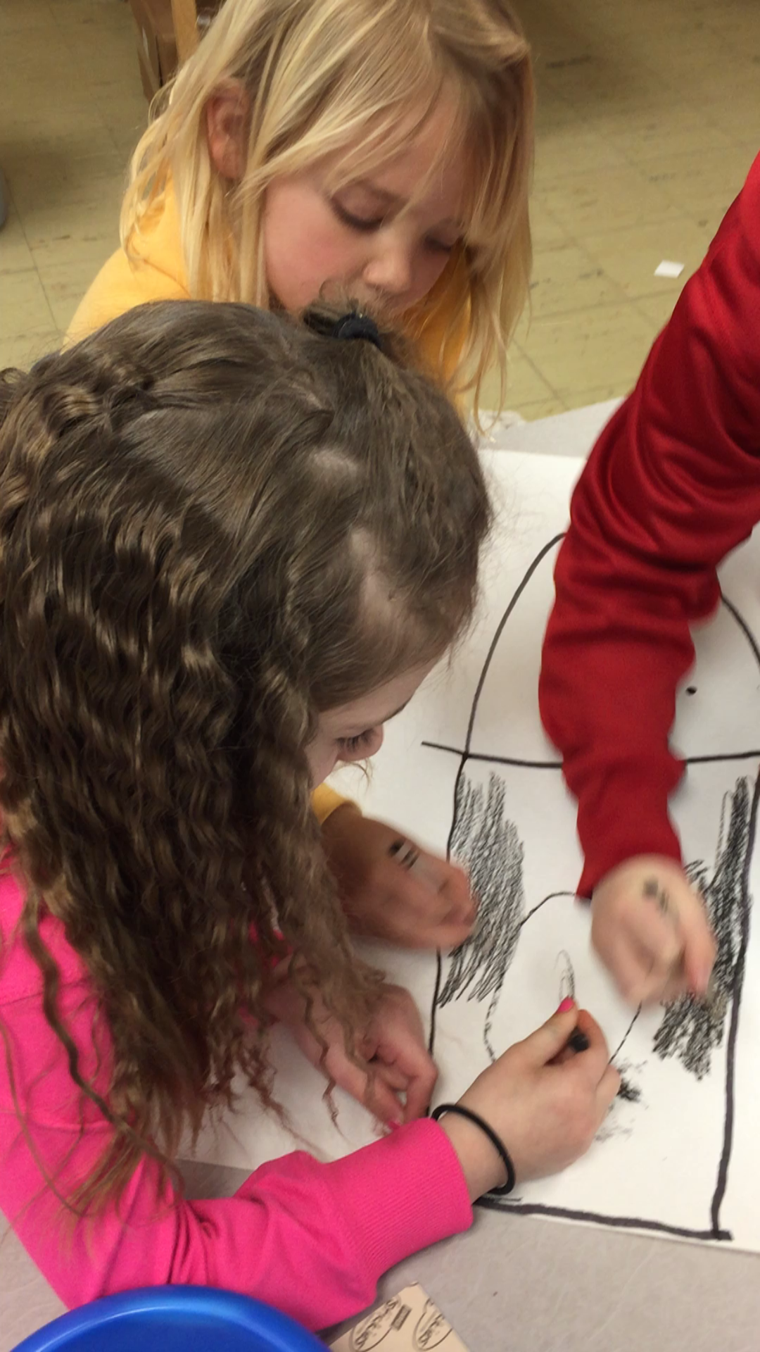
Day 3
Creation of Character Trait Webs
*The children worked in the same groups to create a character trait web about Abe Lincoln. We did a guided drawing activity so they could work together to draw Lincoln on the poster.
*The children looked back into the book at their sticky notes and copied the character words, that they had chosen, on to the character web.

Slide 7
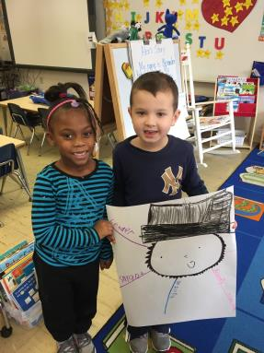
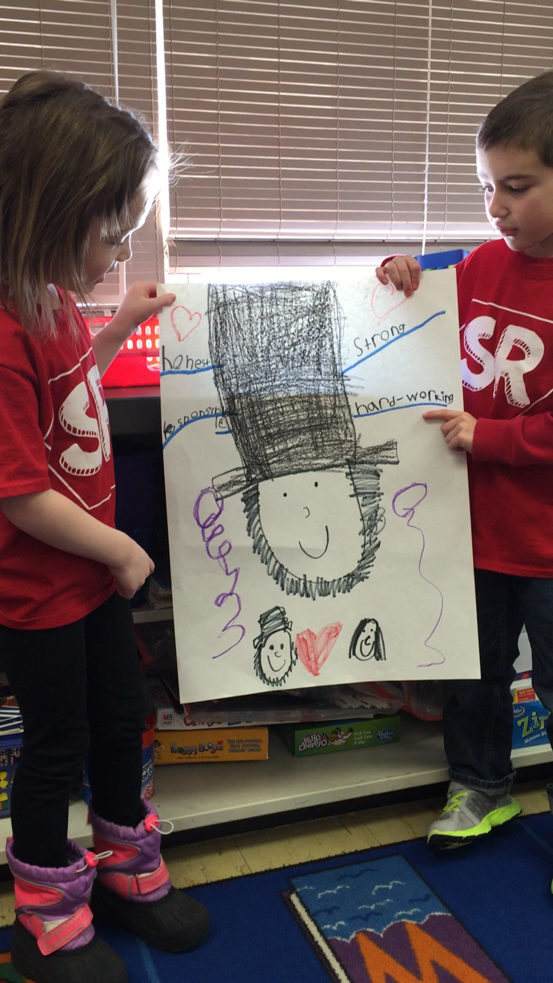
Day 4
Character Web Presentations
*The children presented their character web and gave their opinion about why they chose the traits to represent Lincoln.

